Slide 1

CPQ Door Glass Overview + Training
Rev. 3 – August 29, 2024
Created and Presented By: Josh Gillean

Slide 2
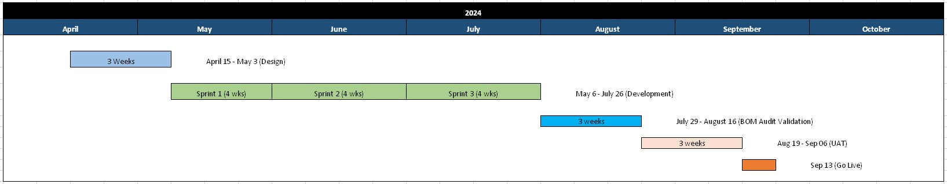
Project Timeline

Slide 3
What is CPQ?
CPQ stands for Configure, Price, Quote
  Configure: This area of CPQ houses engineering rules and a UI that lets users create custom size blind and now new door glass combinations.
  Price: CPQ is the master pricing engine for ODL. All other order entry systems call CPQ for pricing.
  Quote: CPQ is where ODL creates quotes with official proposal documents that can be shared with customers.

Slide 4
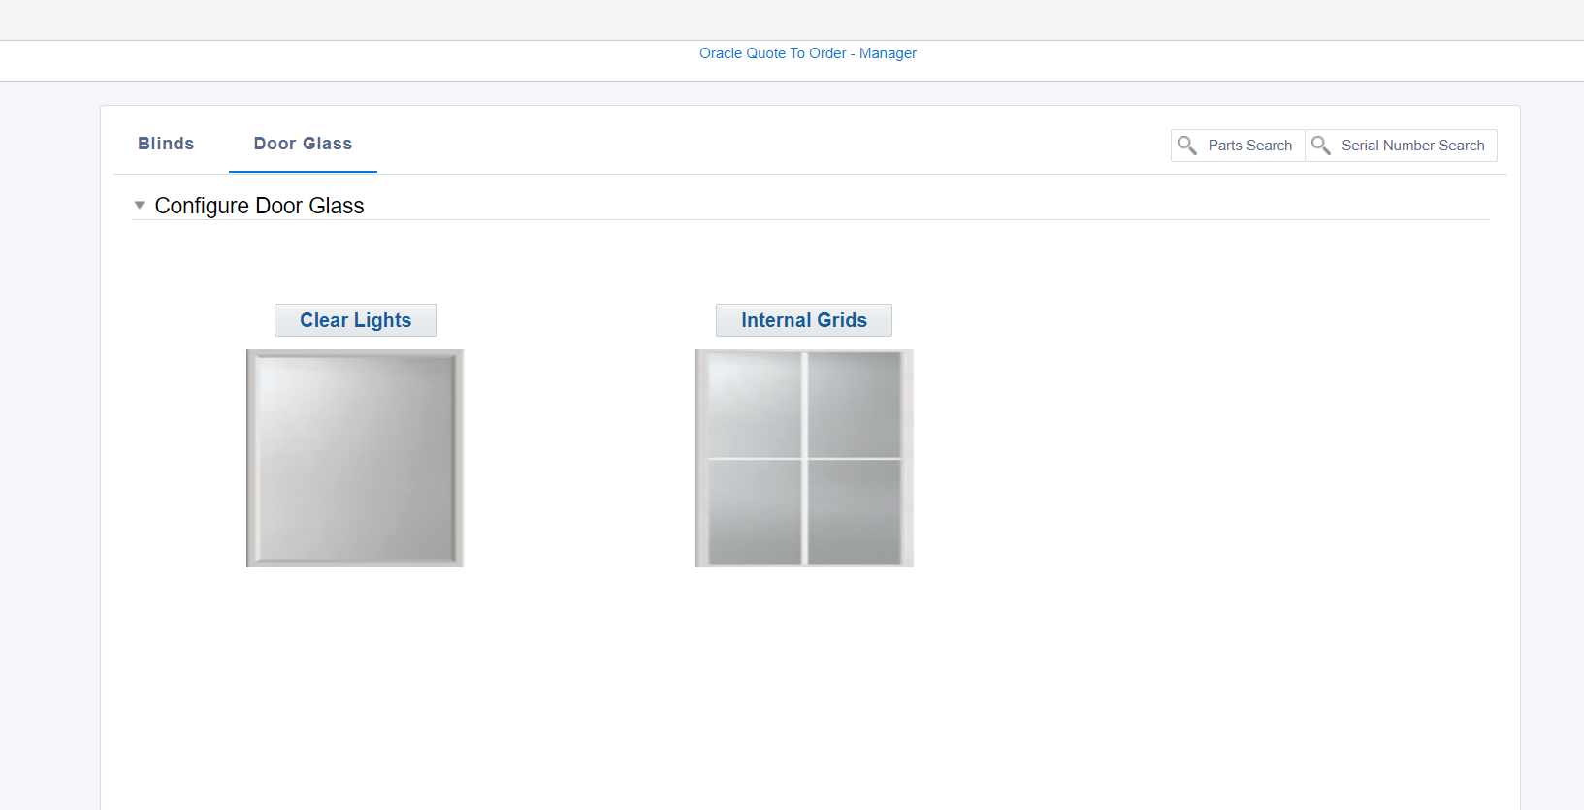
What’s New
CPQ available to 1099/ODL Community Partners
Custom clear glass
Custom GBG’s
No Clearing House!

Slide 5
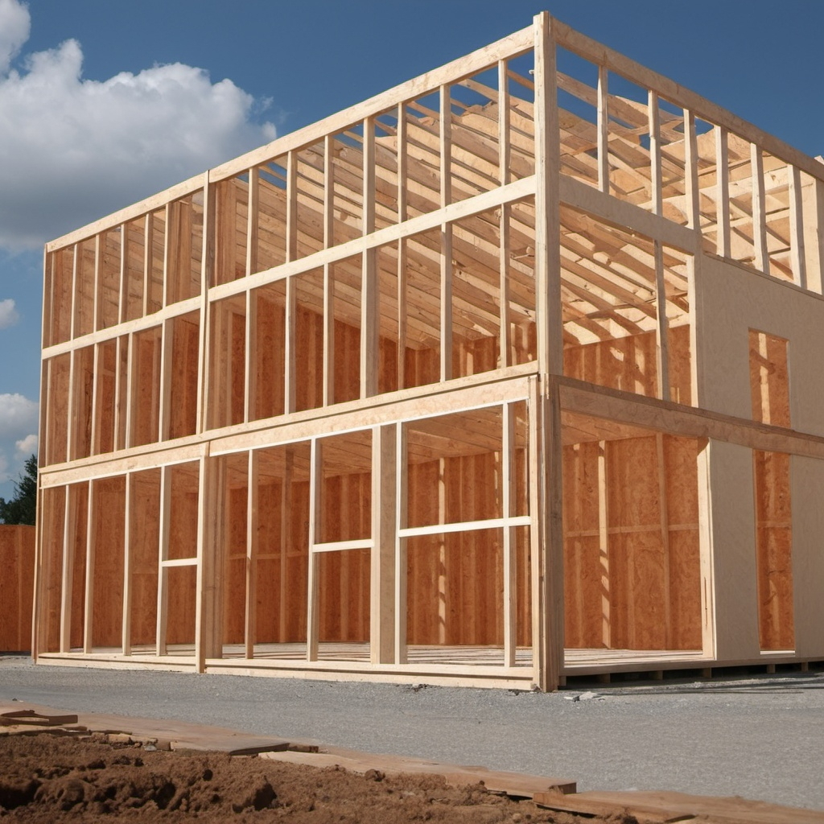
What’s New
Time
  Quote – Instantaneous
  Build time – 4 weeks
  No configuration approval process

Slide 6
What’s New
Configure clear single light
  Width
    7”, 8”, 14”, 20”, 22”, and 25”
  Height
    10”, 15.25”, 17”, 36”, 48”, 60”, 64”, 76”, and 80”
  Impact ratings
    Impact
    Non-Impact
  Glass coatings
    Low E 270, Low E 366, Low E CS73
  4 week lead time

Slide 7
What’s New
Configure internal grids (multi light/GBG)
  Width, Height, Impact Rating, and Glass coatings same as clear light
Plus….
  Grid styles
    Arts and Crafts, Prairie, Classic GBG
  Bar profiles
    Standard Flat (5/8), Wide Flat (7/8), and Contoured (11/16)
  Bar Colors
    White, Champagne, Black, Bronze, Tan, Bronze/White
Number of horizontal and vertical bars
4 week lead time

Slide 8
What’s Not Included
Various IG thicknesses (1/2”, 5/8”, 7/8”)
Sizes not listed
External grids
Low E options not carried by ODL
Bar colors not carried by ODL
Packaging options

Slide 9

Objective
Quickly add door glass products without having to go through the traditional New Item Request (NIR) process.
Less manual work creating item structures, work definitions, pricing.
Increase in accuracy.
Part numbers created
  Can be reused

Slide 10
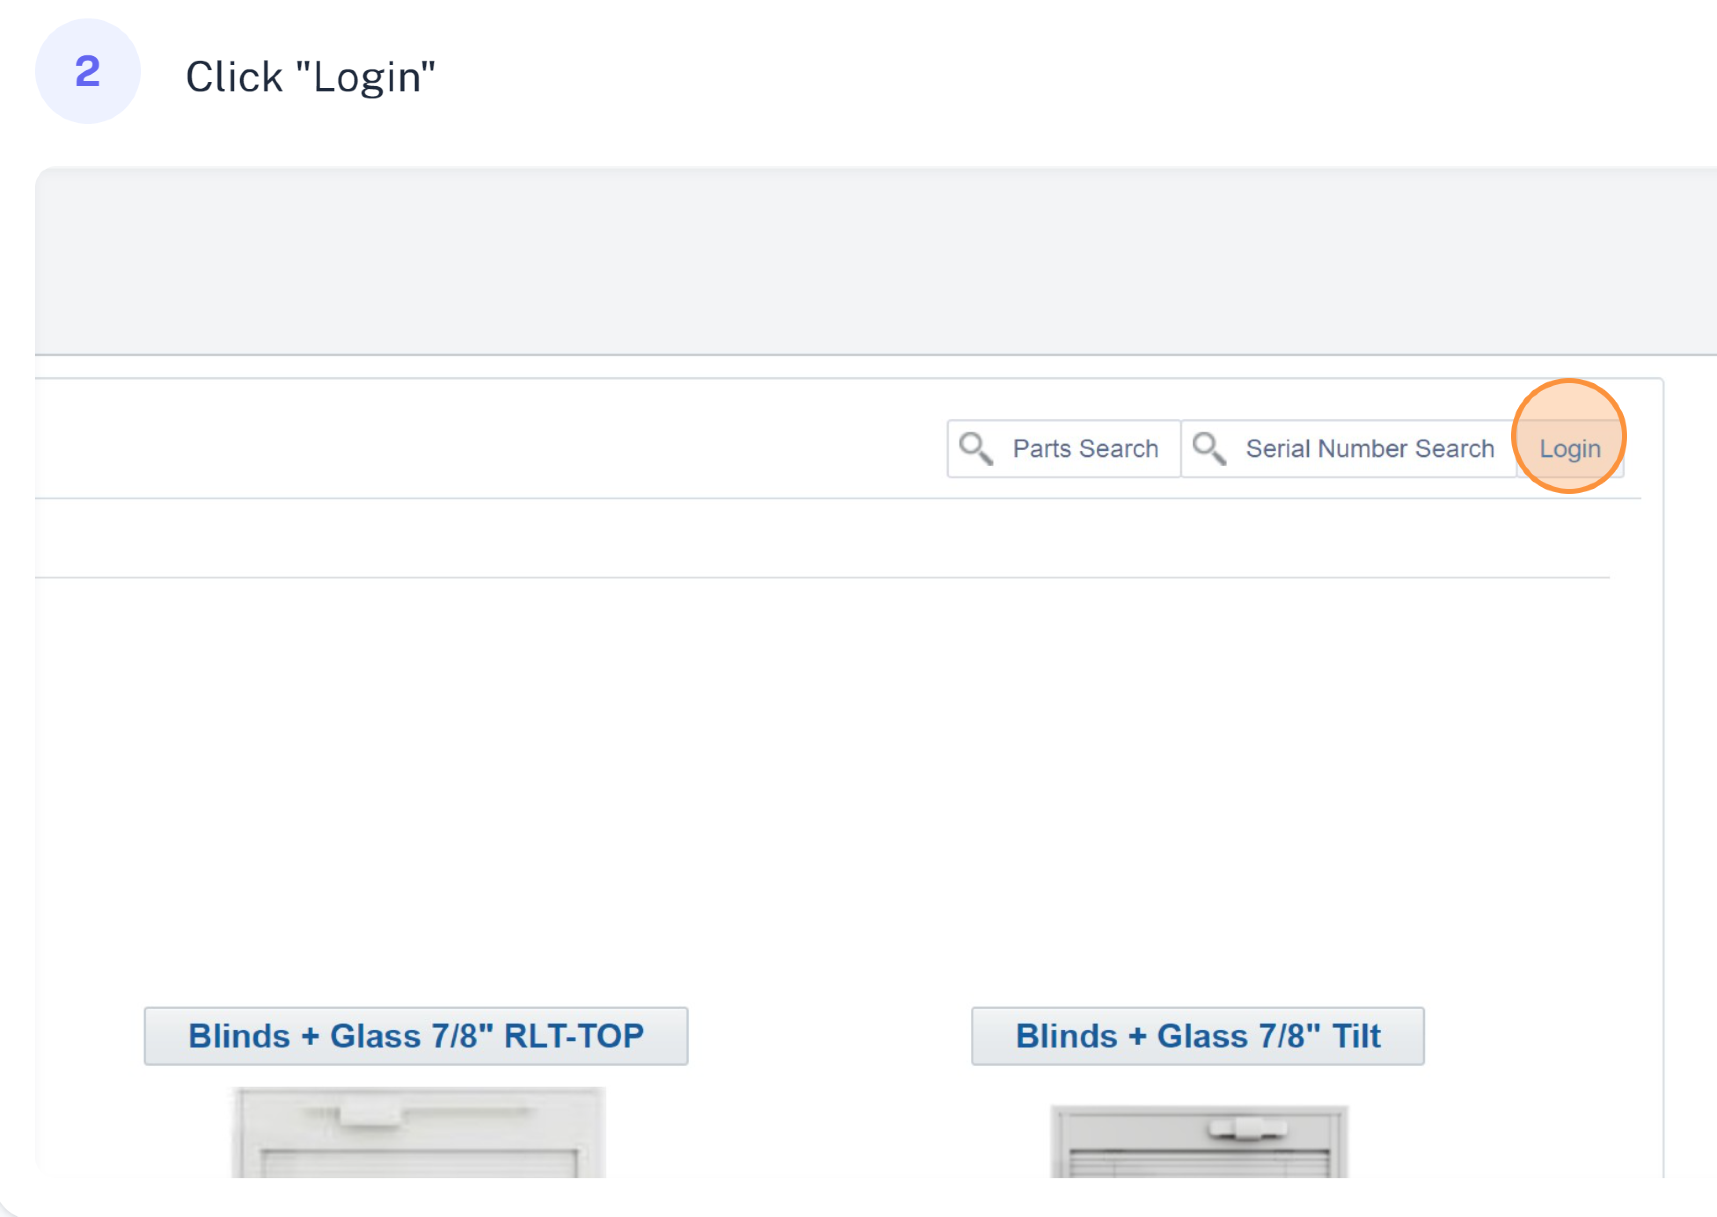
Login
URL
  Log in to CPQ https://odl.bigmachines.com

Slide 11
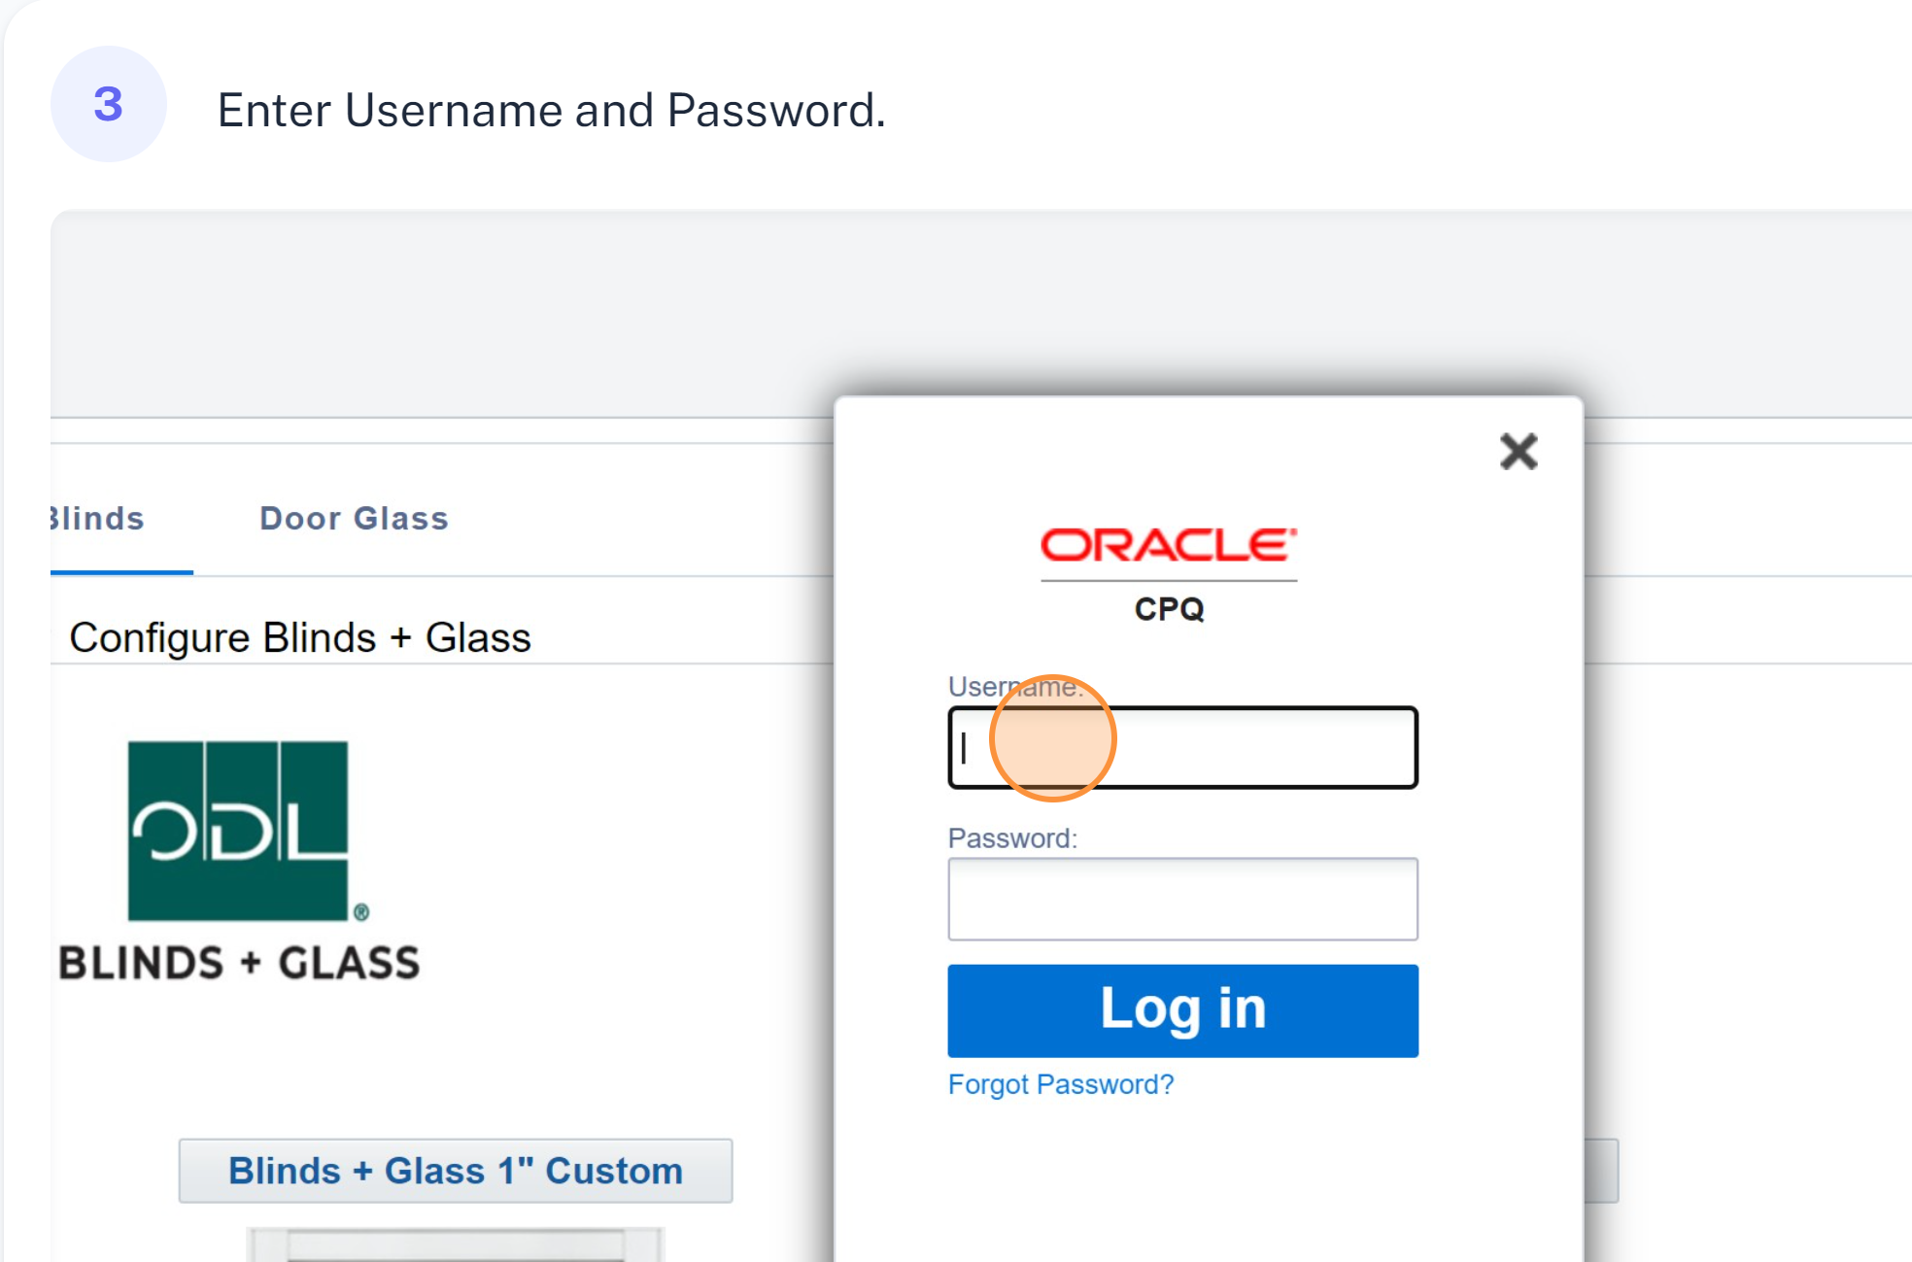
Login

Slide 12
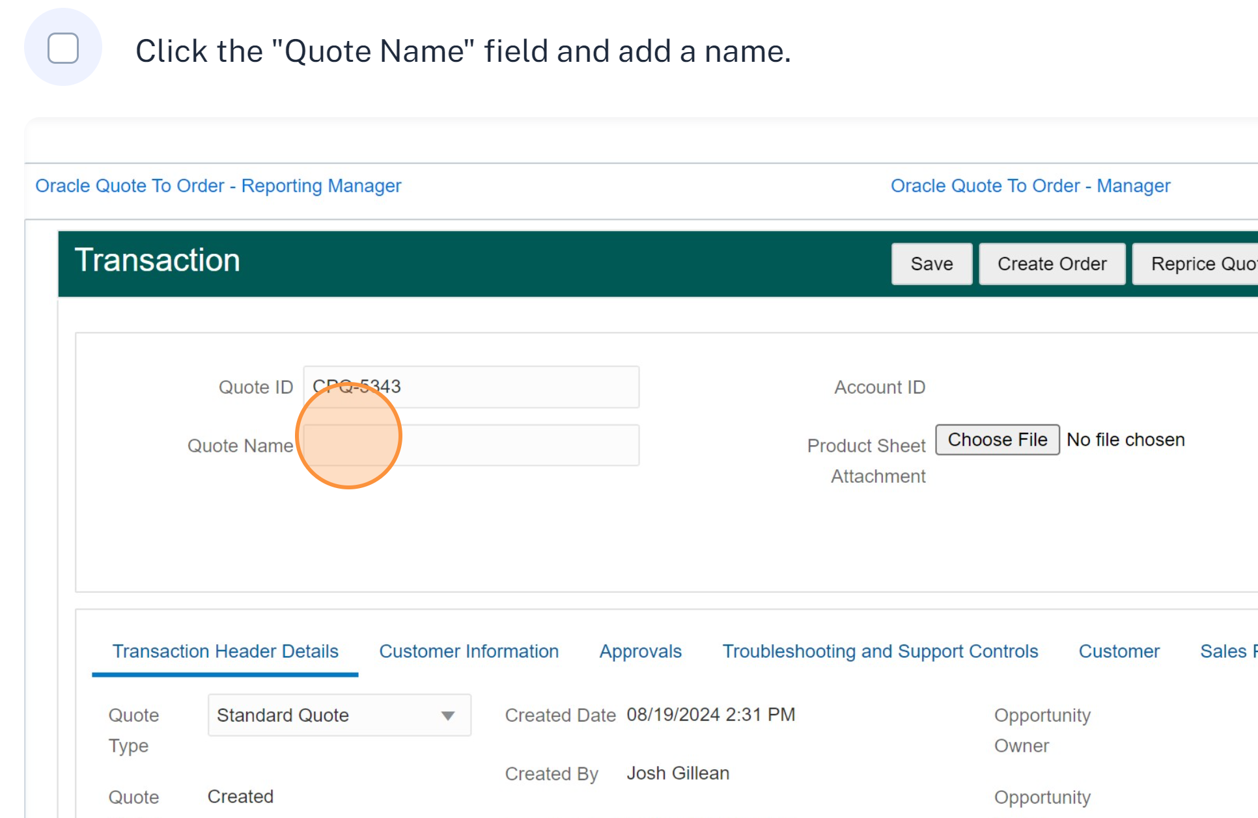
Naming the Quote

Slide 13
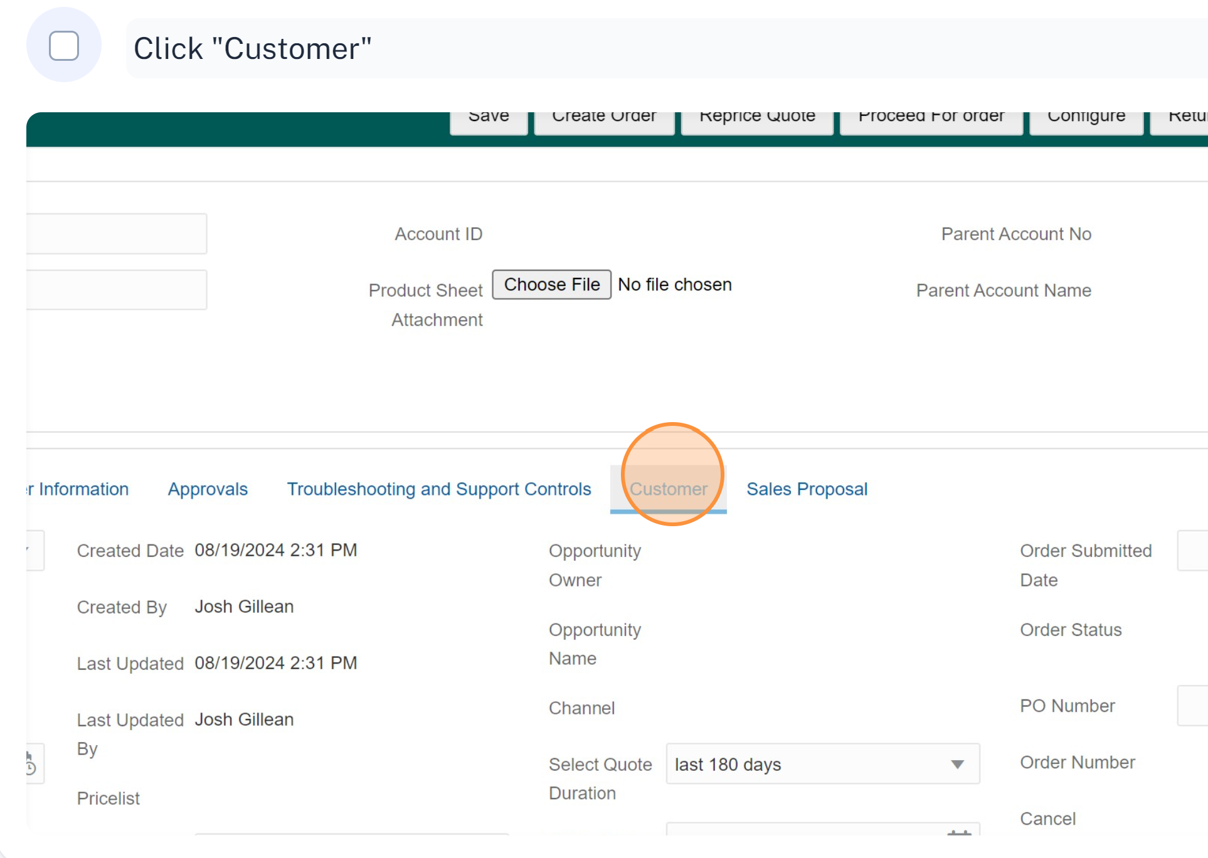
Choosing A Customer

Slide 14
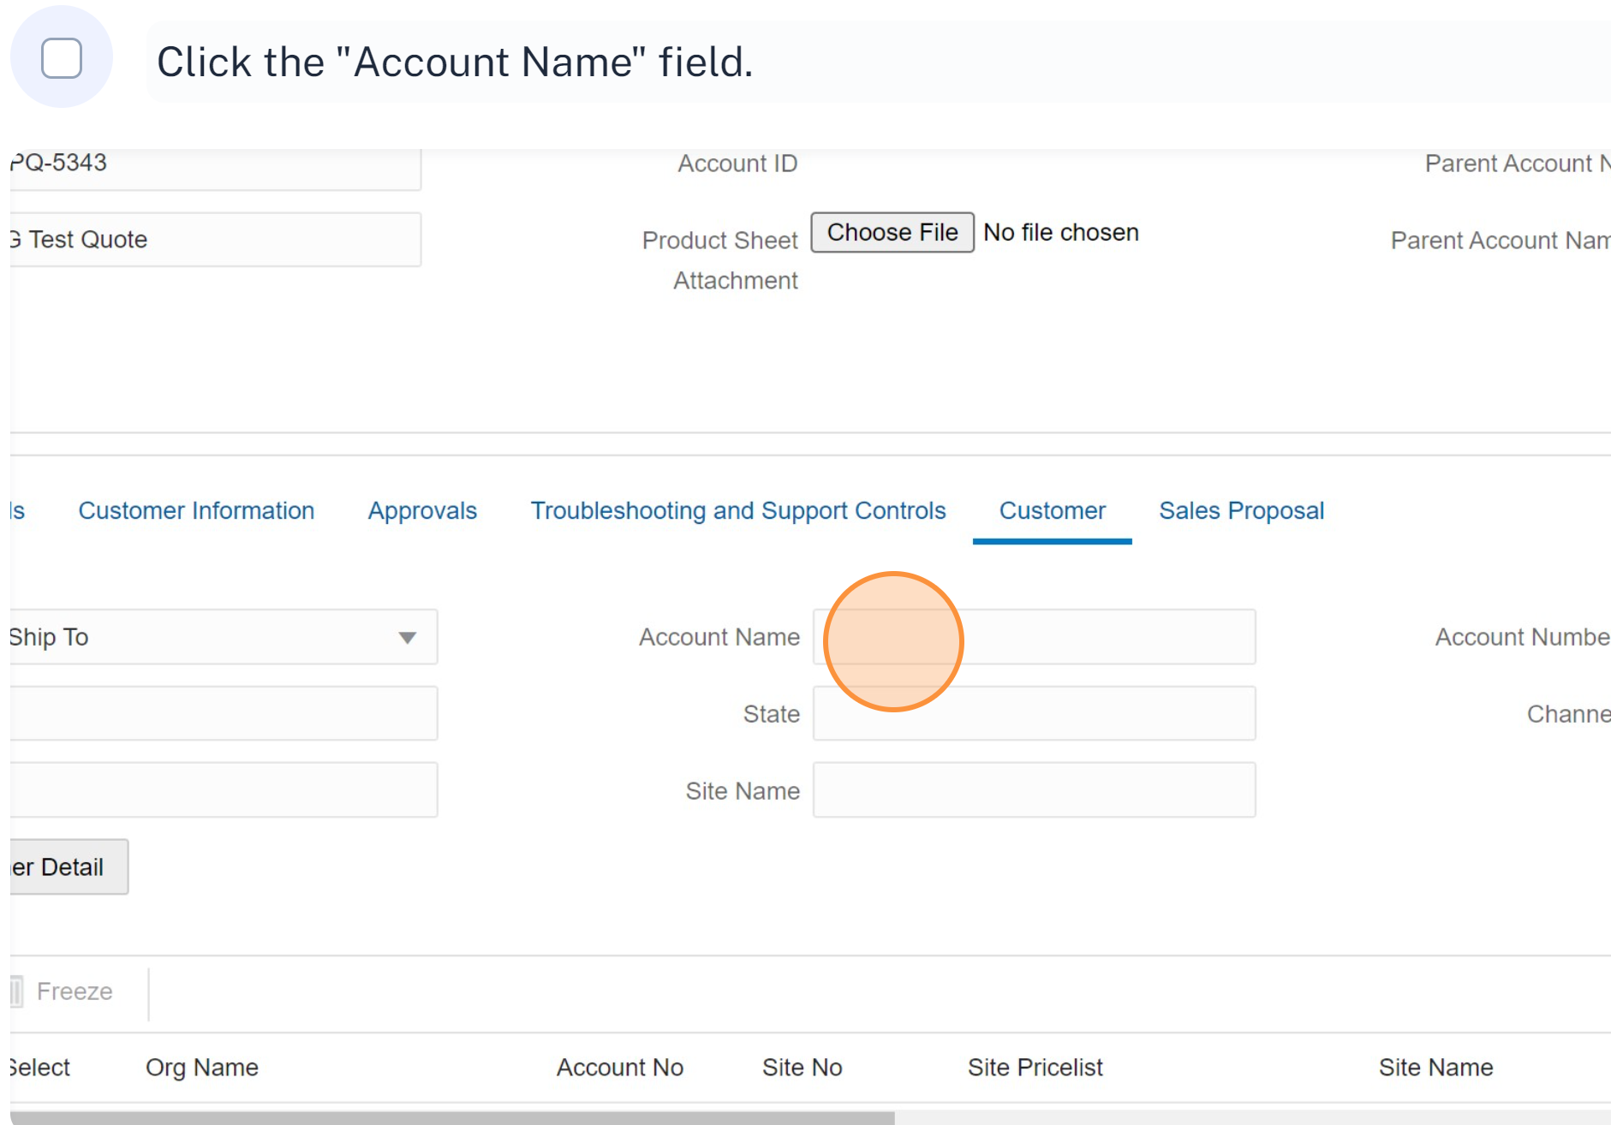
Choosing A Customer

Slide 15
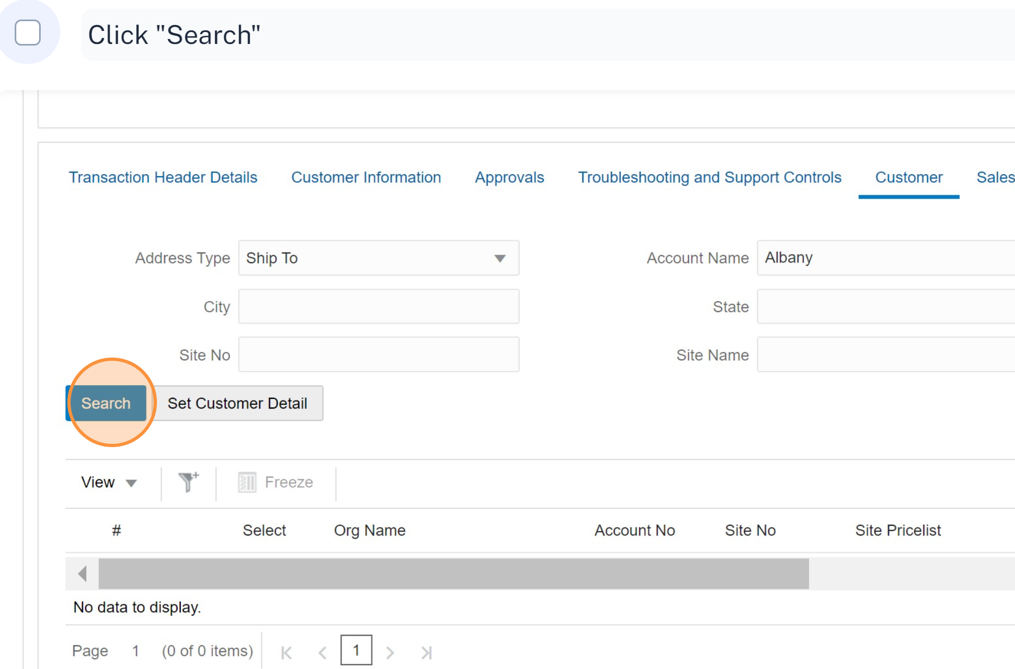
Choosing A Customer

Slide 16
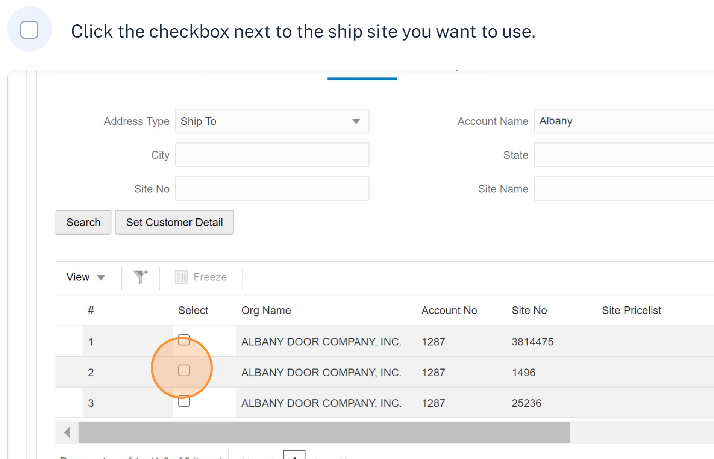
Choosing A Customer

Slide 17
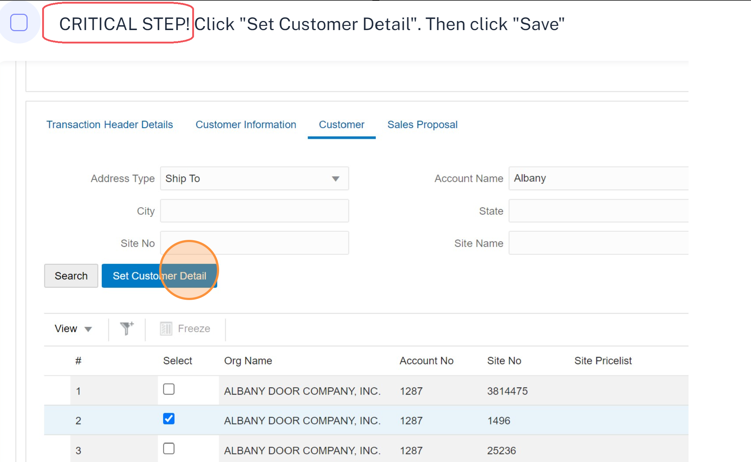
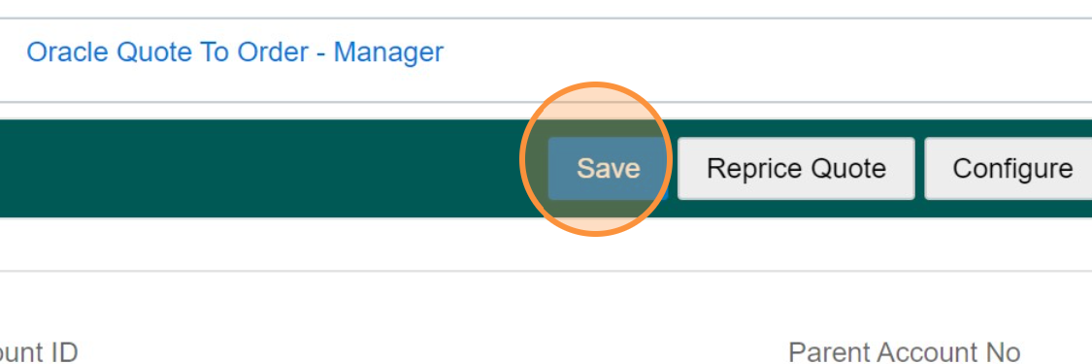
Choosing A Customer

Slide 18
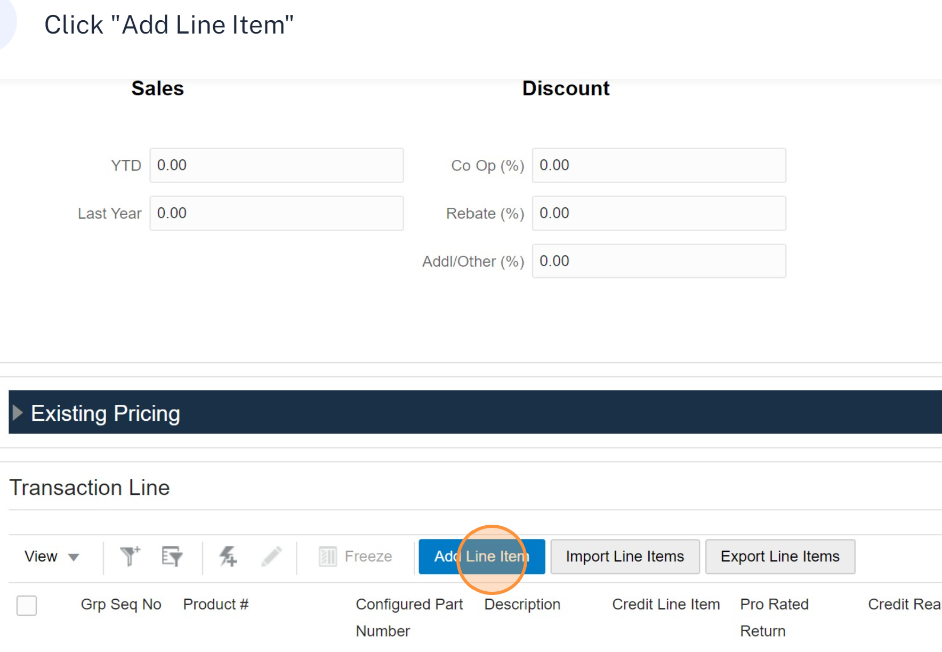
Configuring Door Glass

Slide 19
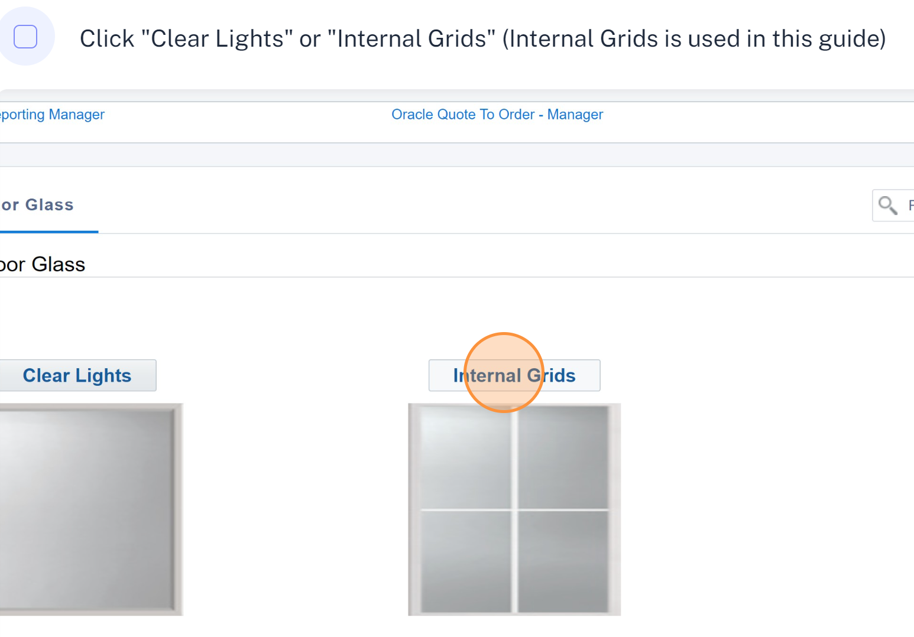
Configuring Door Glass - Type

Slide 20
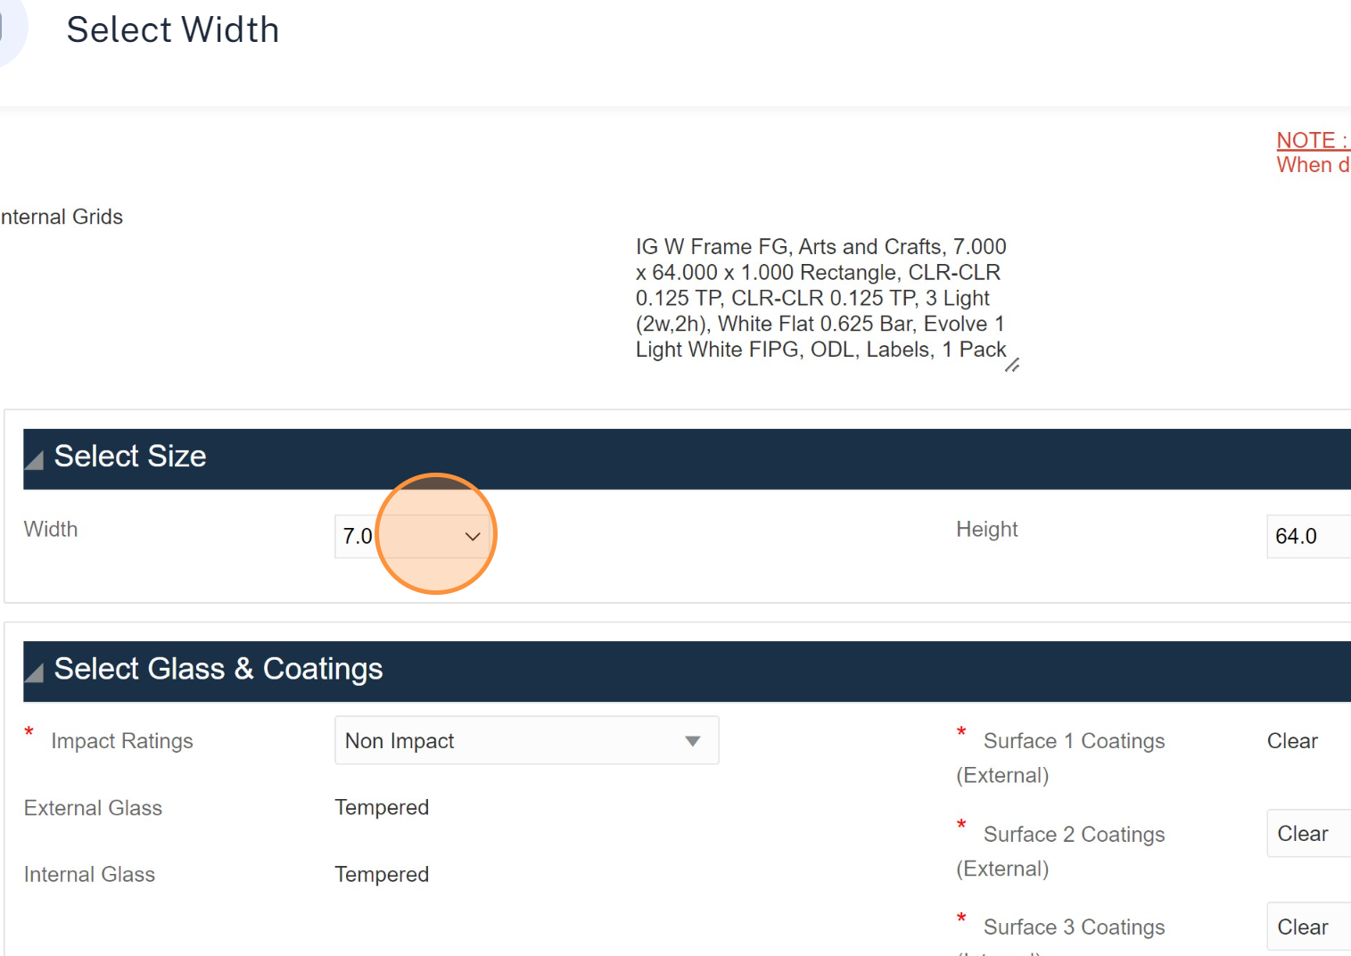
Configuring Door Glass - Width

Slide 21
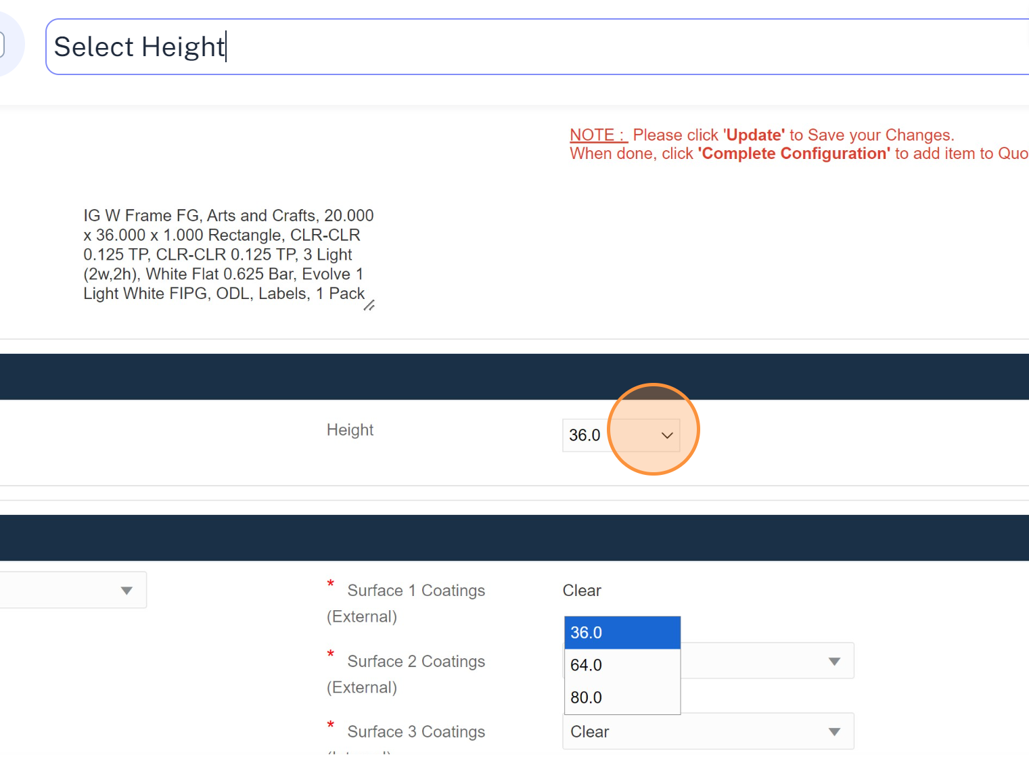
Configuring Door Glass - Height

Slide 22
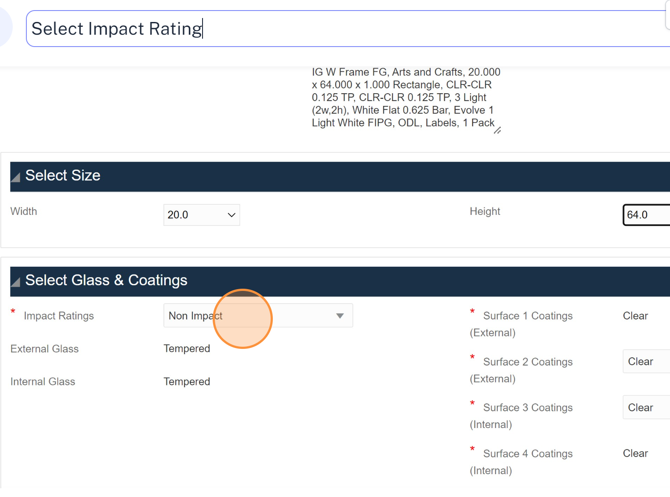
Configuring Door Glass – Impact Rating

Slide 23
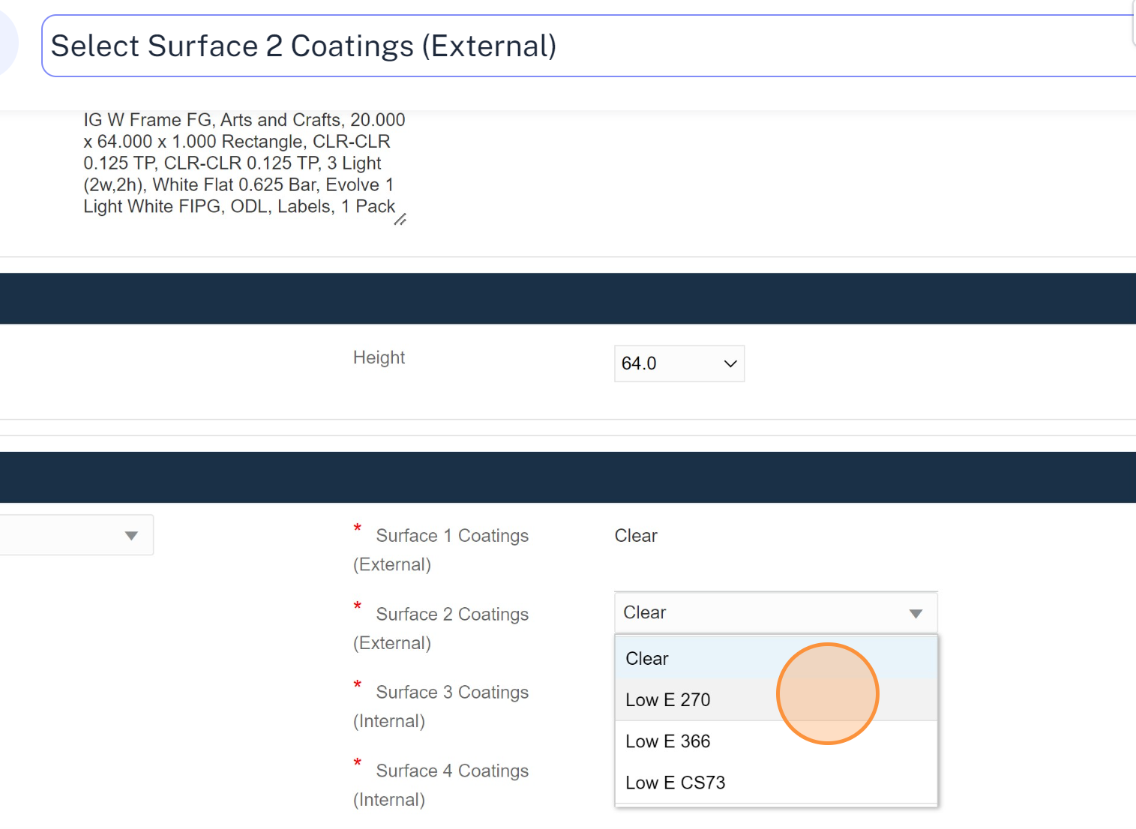
Configuring Door Glass – Surface 2 Coating

Slide 24
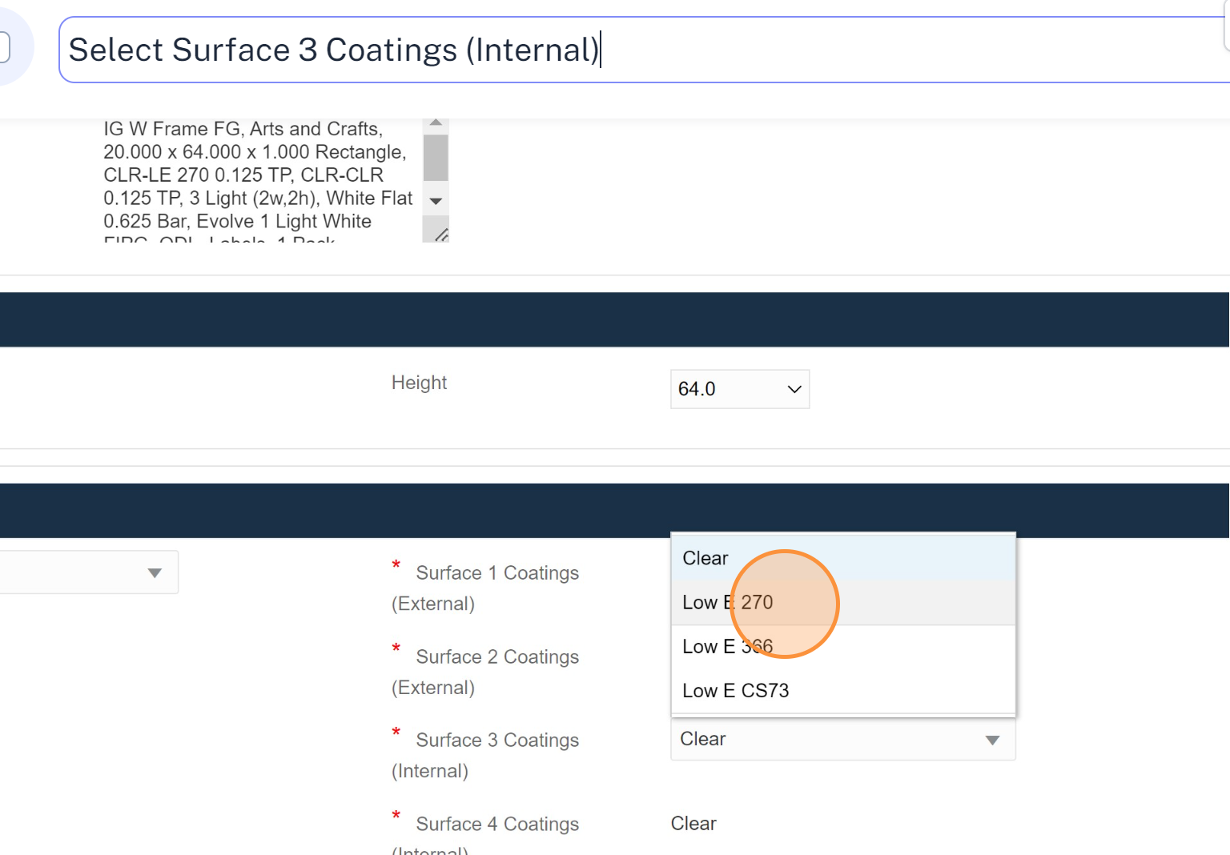
Configuring Door Glass – Surface 3 Coating

Slide 25
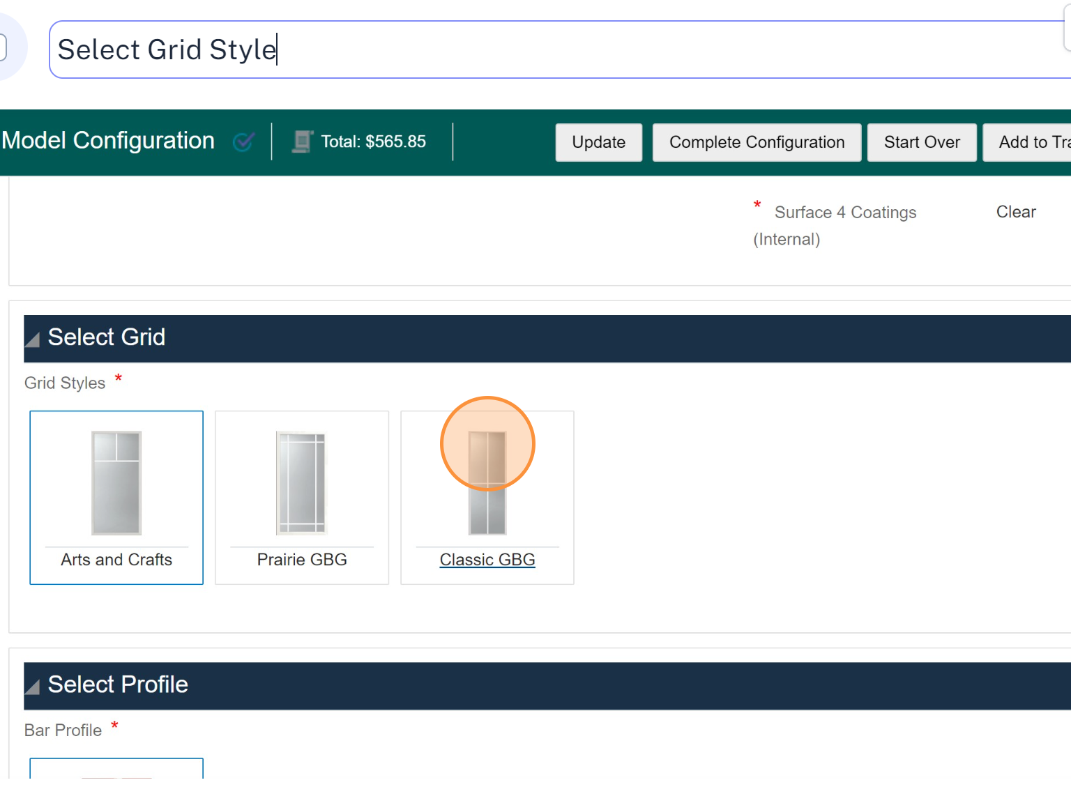
Configuring Door Glass – Grid Style

Slide 26
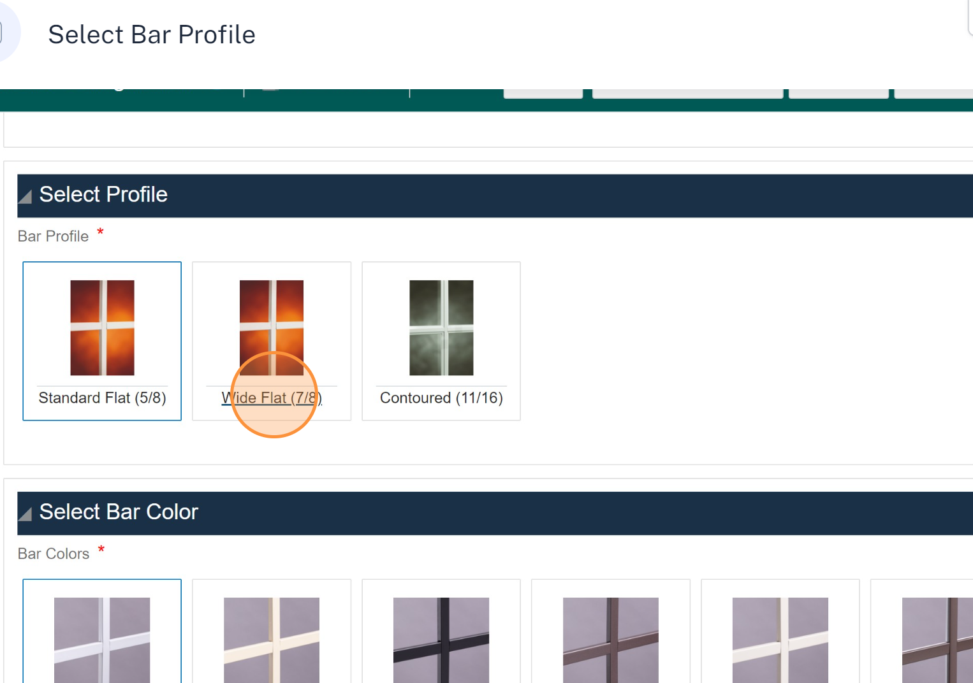
Configuring Door Glass – Bar Profile

Slide 27
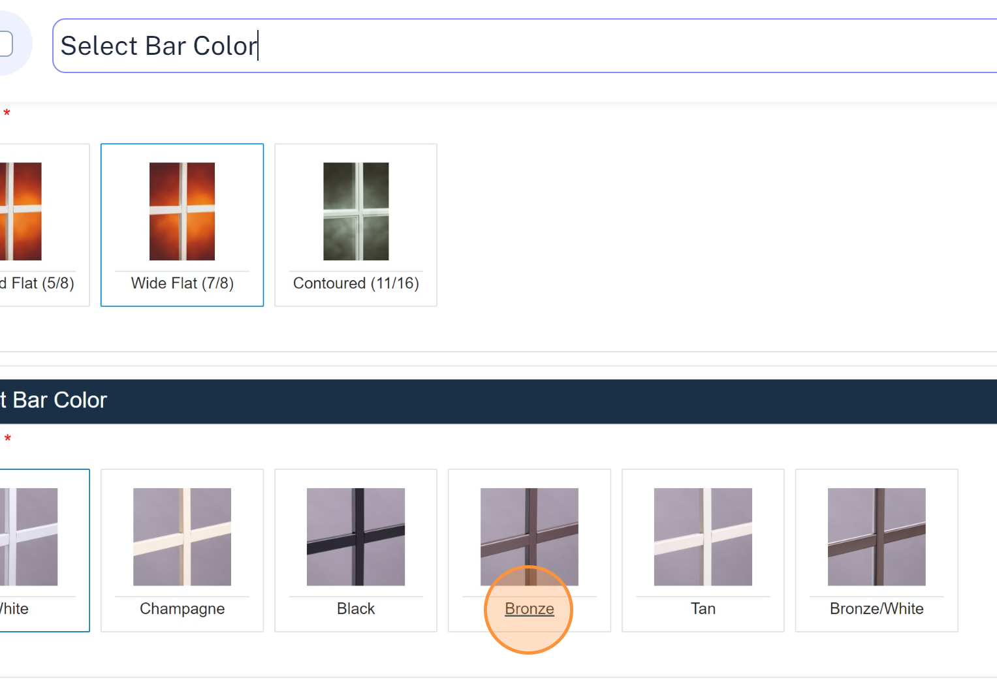
Configuring Door Glass – Bar Color

Slide 28
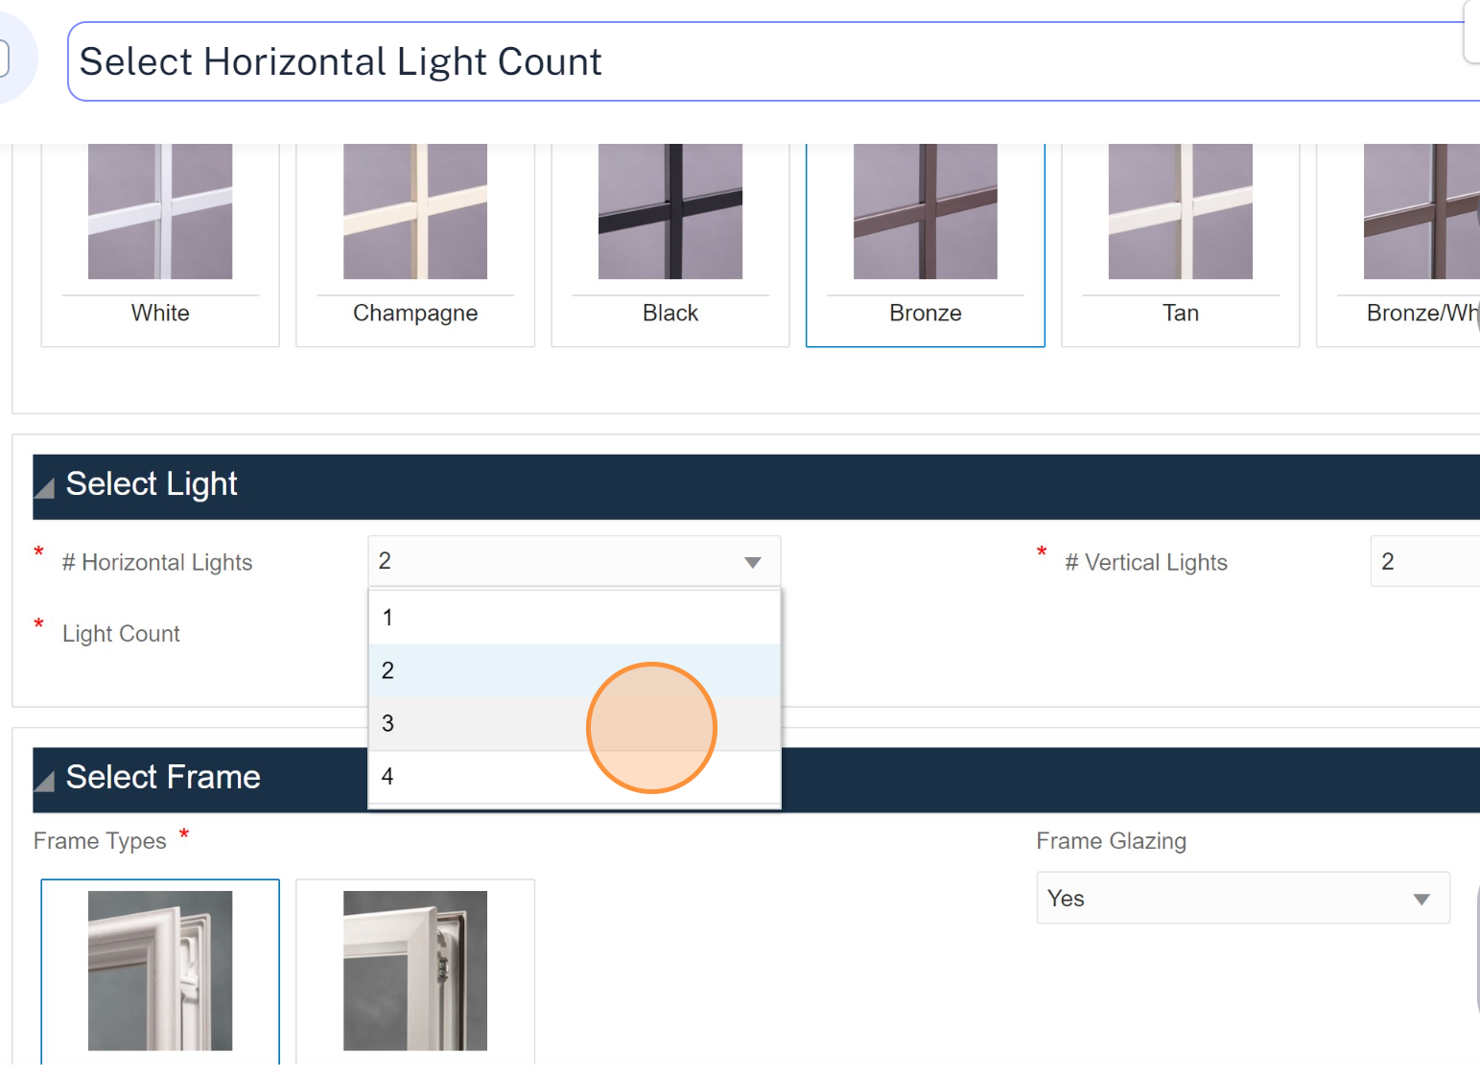
Configuring Door Glass – Horizontal Light Count

Slide 29
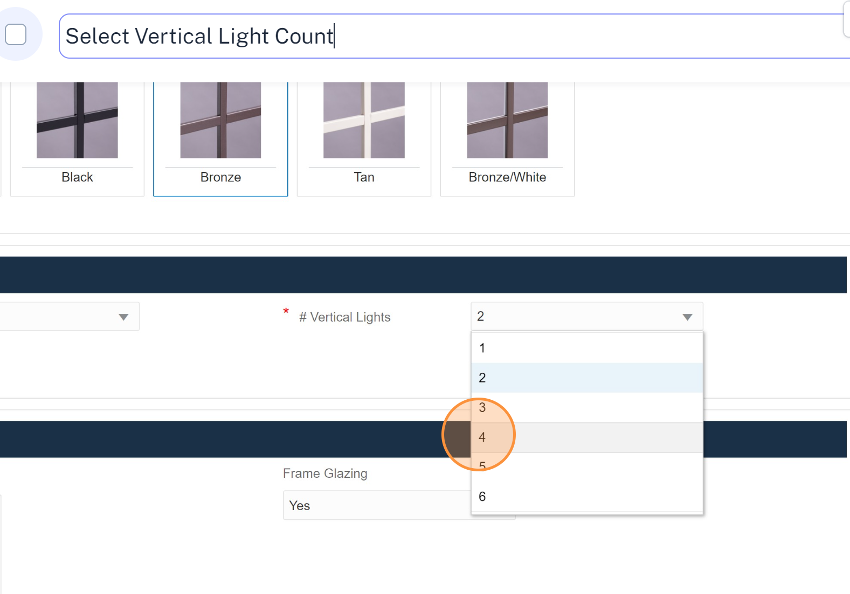
Configuring Door Glass – Vertical Light Count

Slide 30
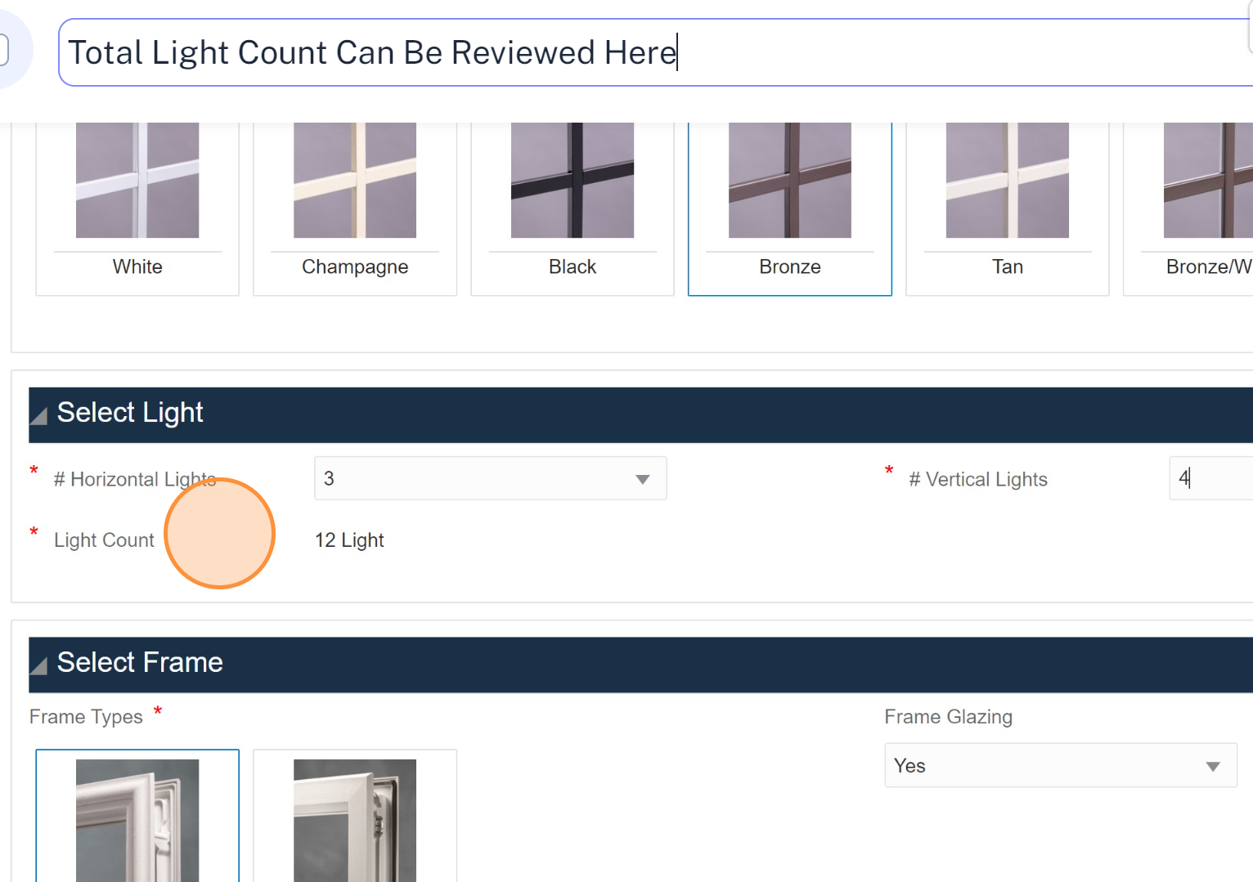
Configuring Door Glass – Review Light Count

Slide 31
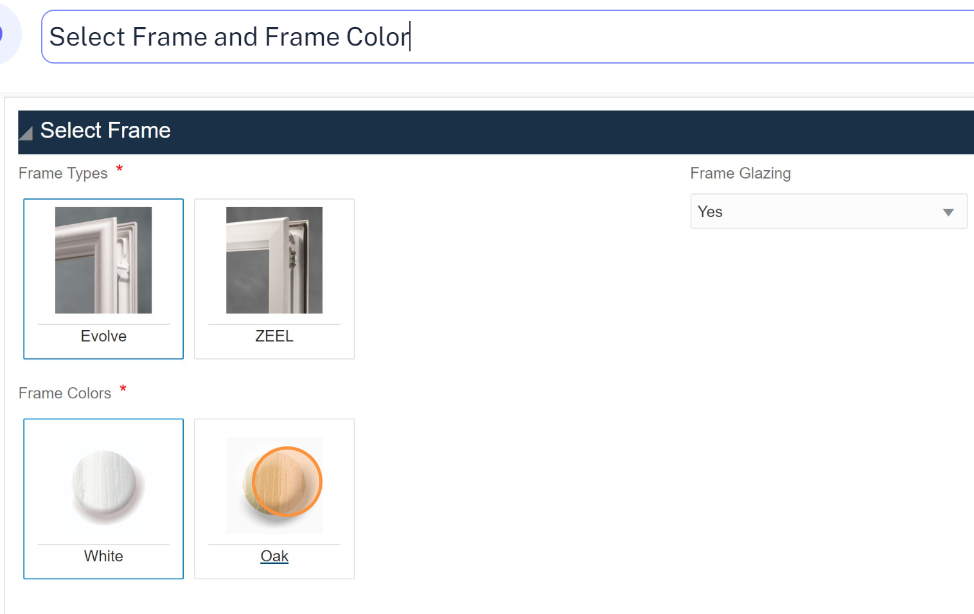
Configuring Door Glass – Frame Options

Slide 32
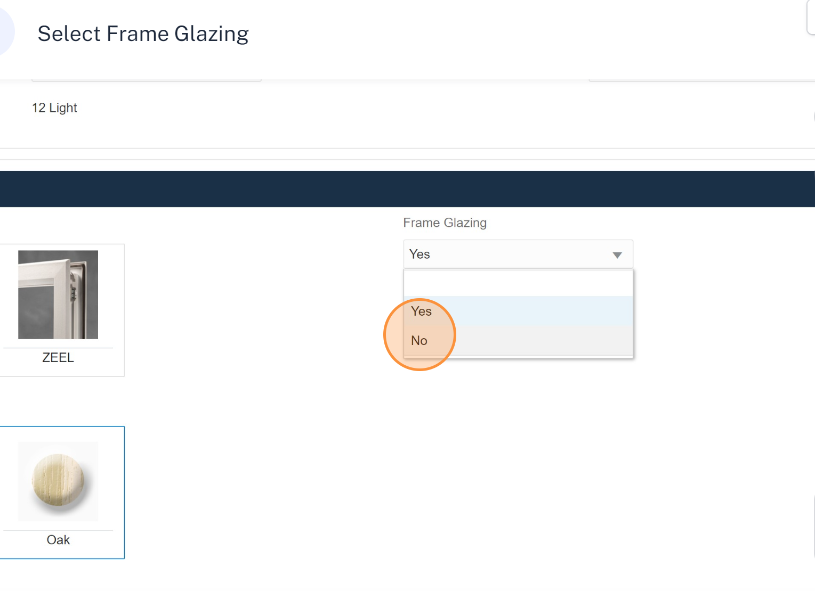
Configuring Door Glass – Frame Glazing

Slide 33
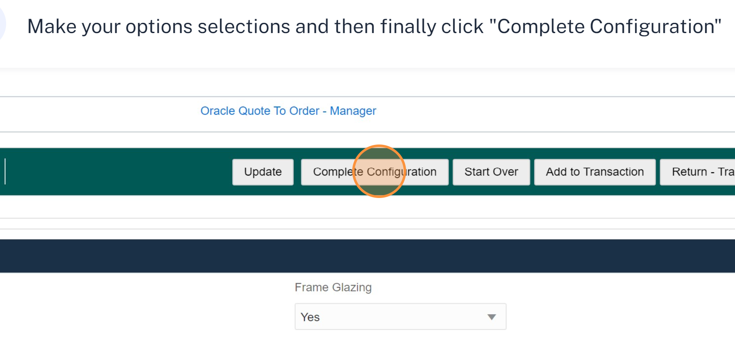
Configuring Door Glass

Slide 34
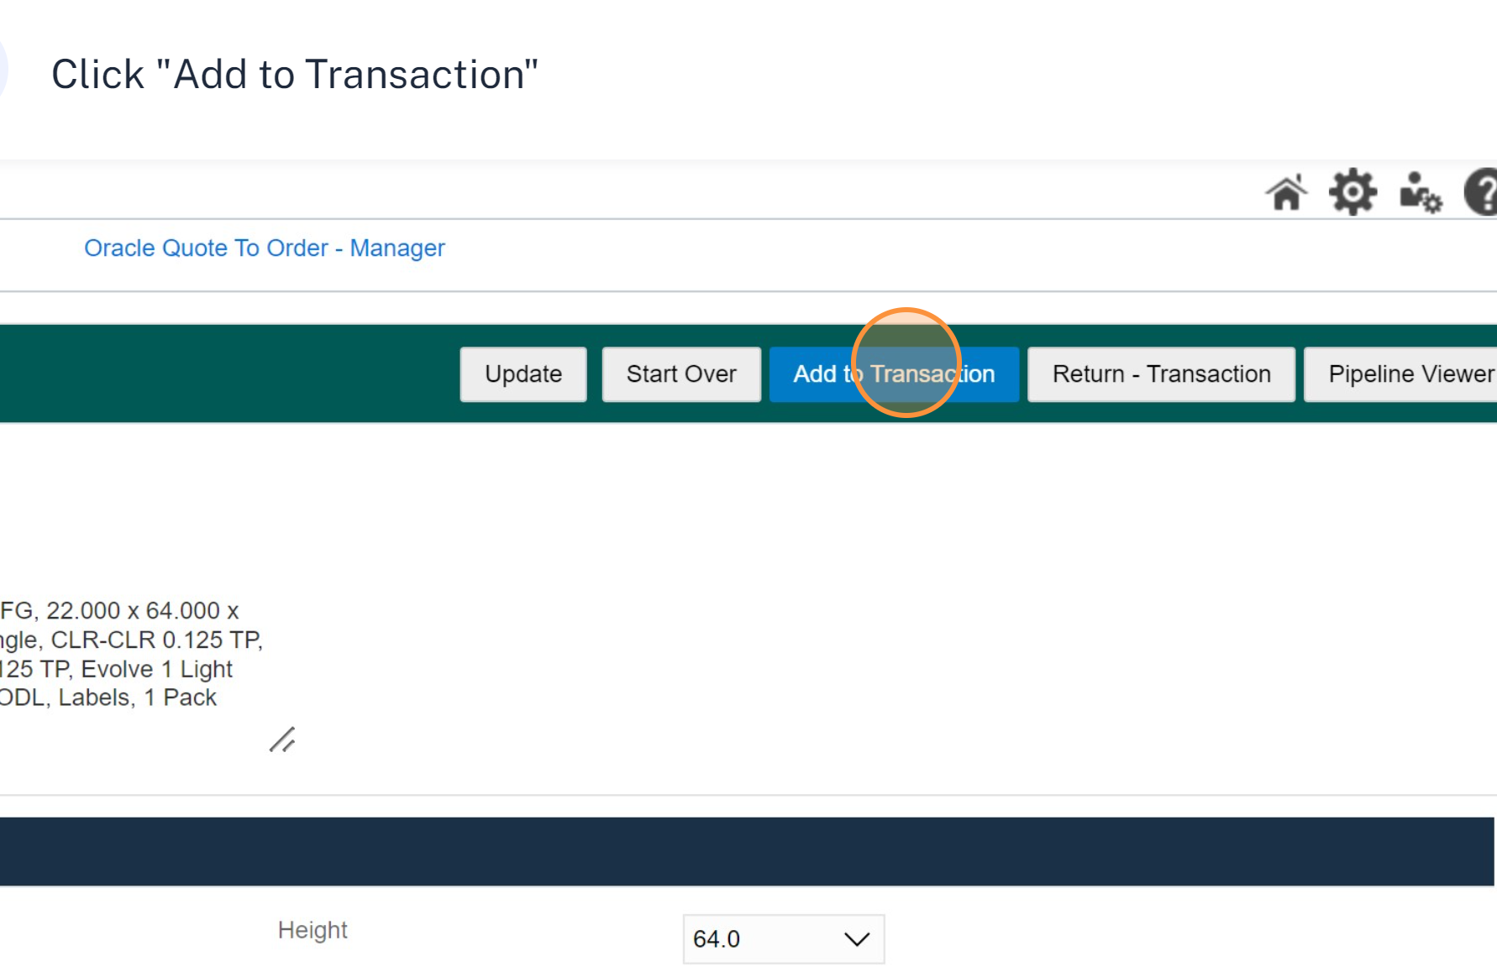
Configuring Door Glass

Slide 35
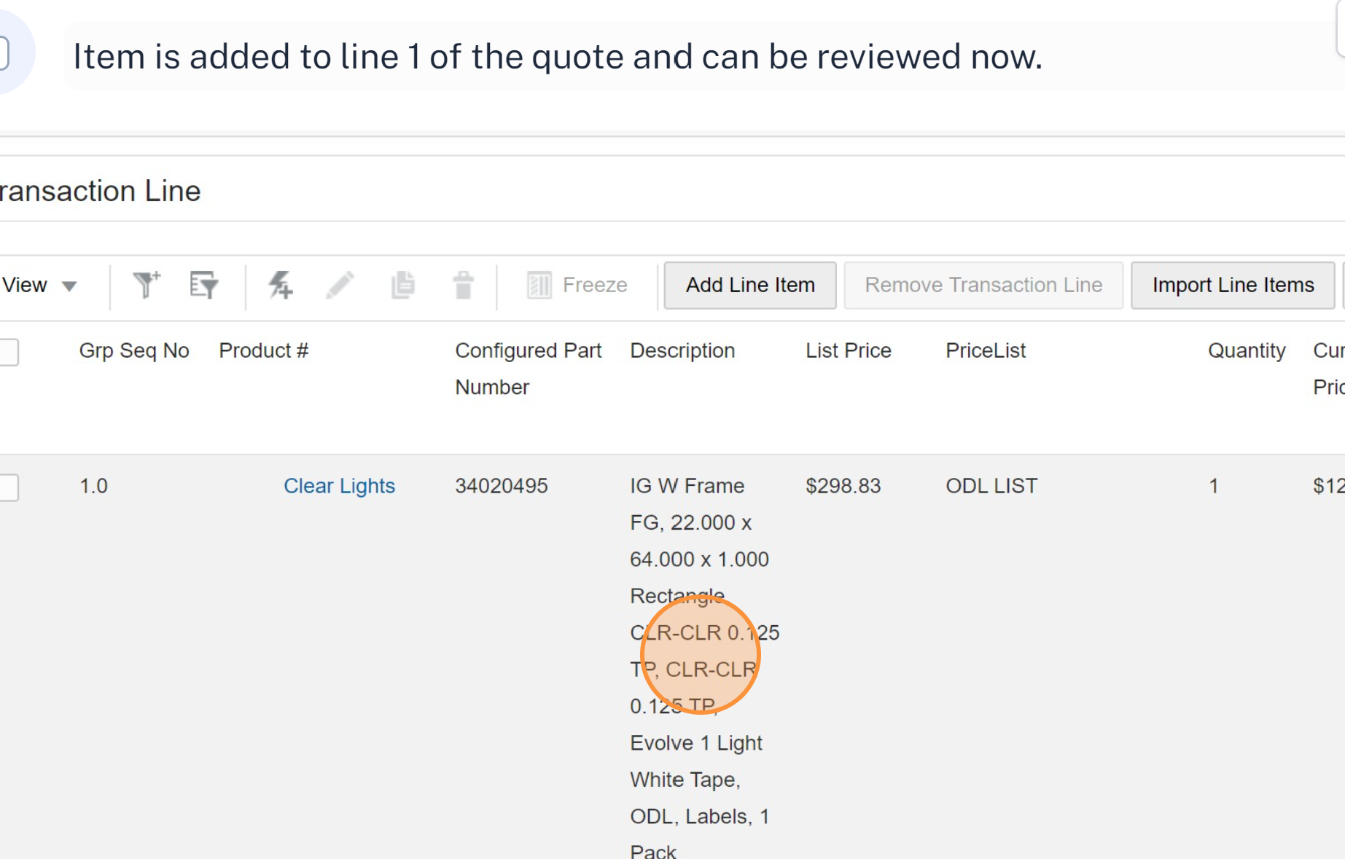
Reviewing Quote Lines

Slide 36
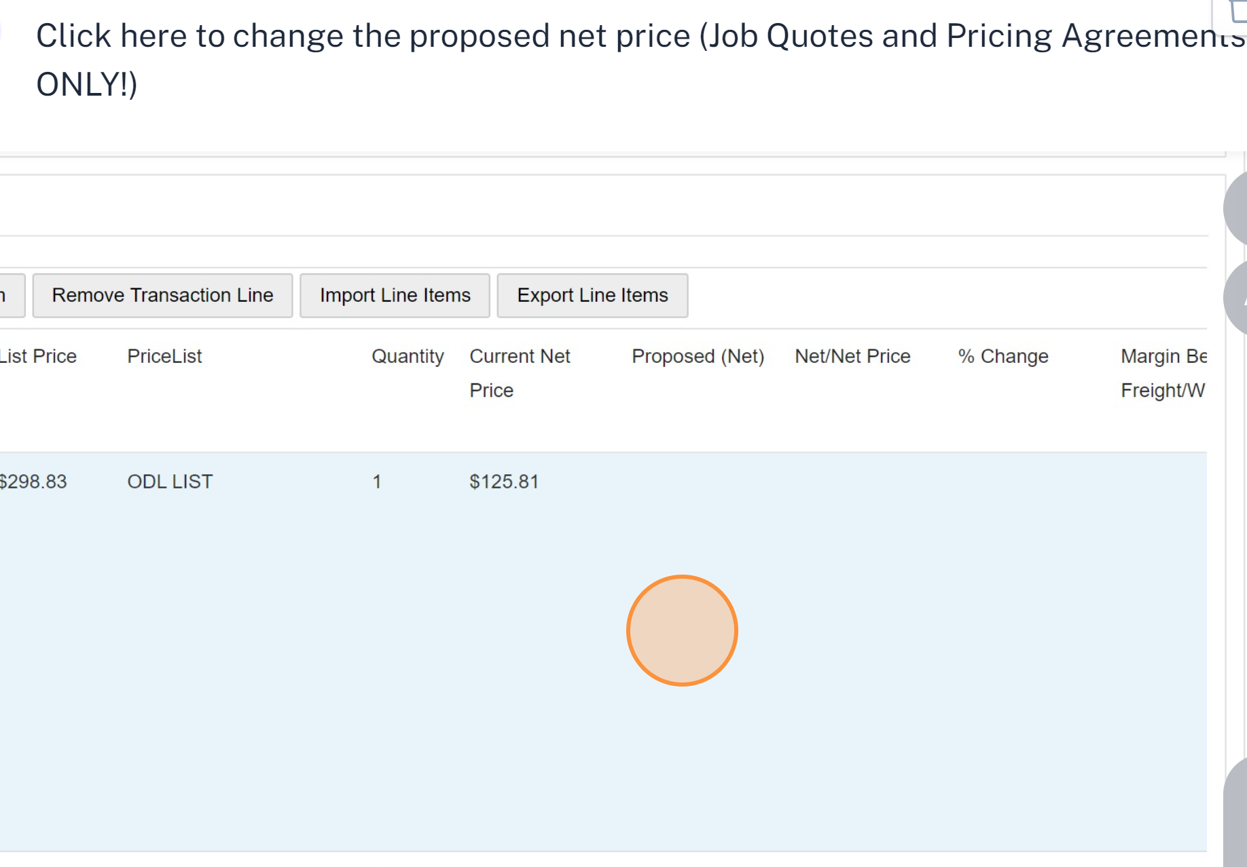
Changing Proposed Net Pricing

Slide 37
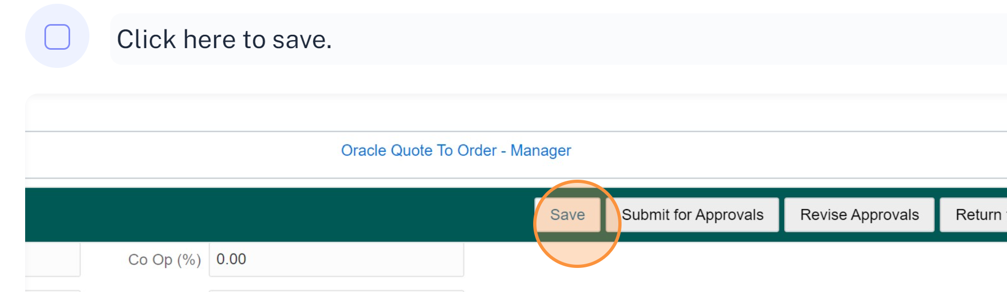
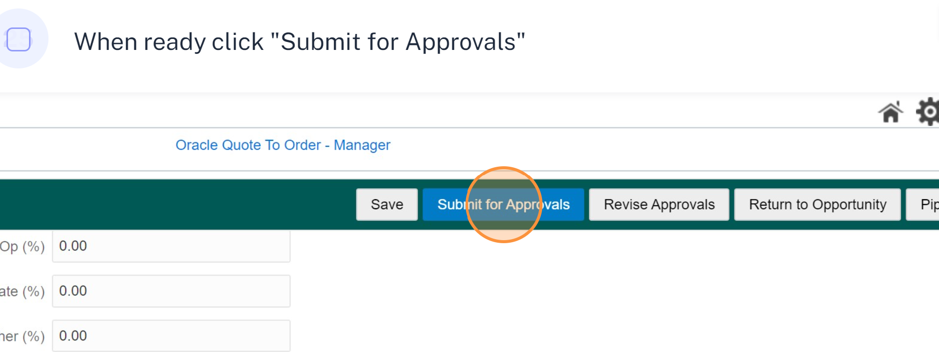
Final Save + Submit For Approvals

Slide 38
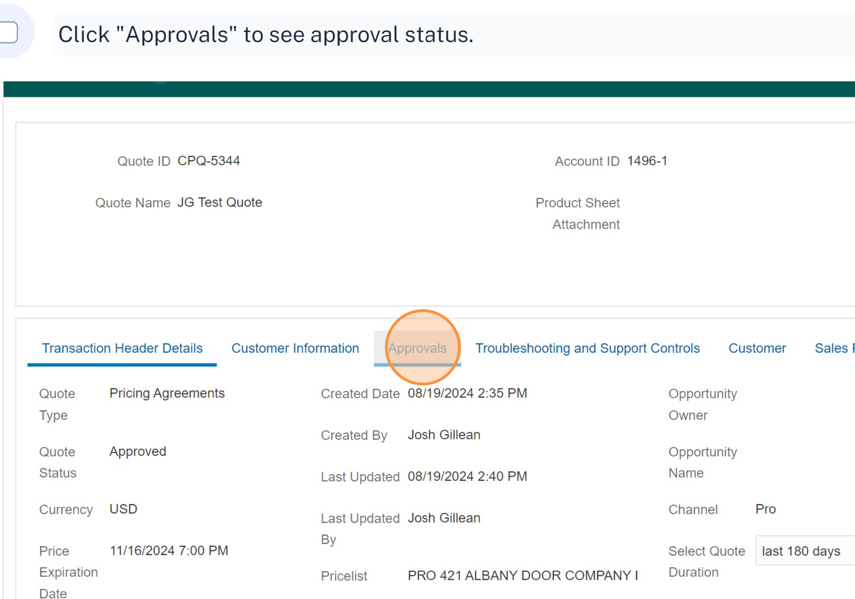
Viewing Approval Status

Slide 39
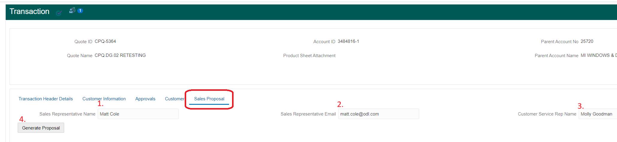
Generate Proposal Documents
Navigate to the Sales Proposal tab
Fill out Sales rep, Sales rep email, CS name
Click generate proposal
Proposal displays in a pop-up window.
Ensure your browser isn’t blocking pop-ups.

Slide 40
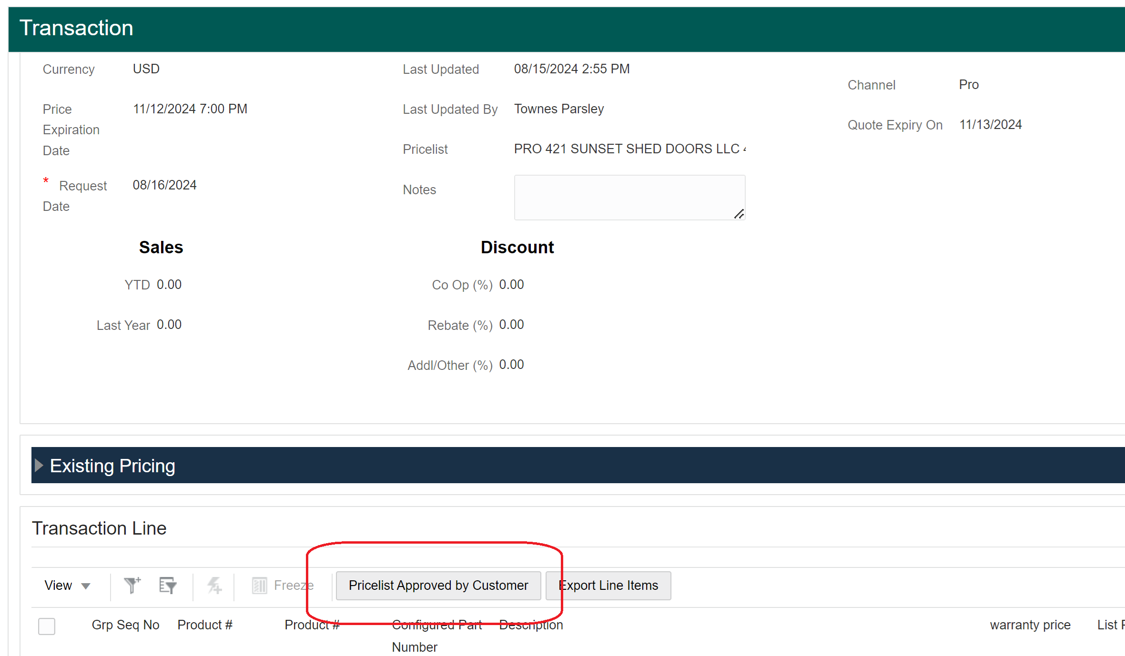
Confirming Customer Quote Approval
Once a customer approves the proposed pricing agreement pricing, the Sales user will go back into the quote and click the “Pricelist Approved by Customer” button in CPQ shown below. This is the last step for Sales.

Slide 41
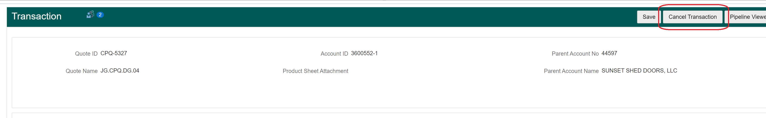
Repricing Unapproved Quotes
What to do when the customer doesn’t approve the proposed pricing on the quote.
  Adjustments can be made all through the approval process, but once the quote is approved at the final level, it can’t be modified.
  Pricing Manager (Nancy Cannon) can cancel the transaction. Shown below with additional steps in next slide.

Slide 42
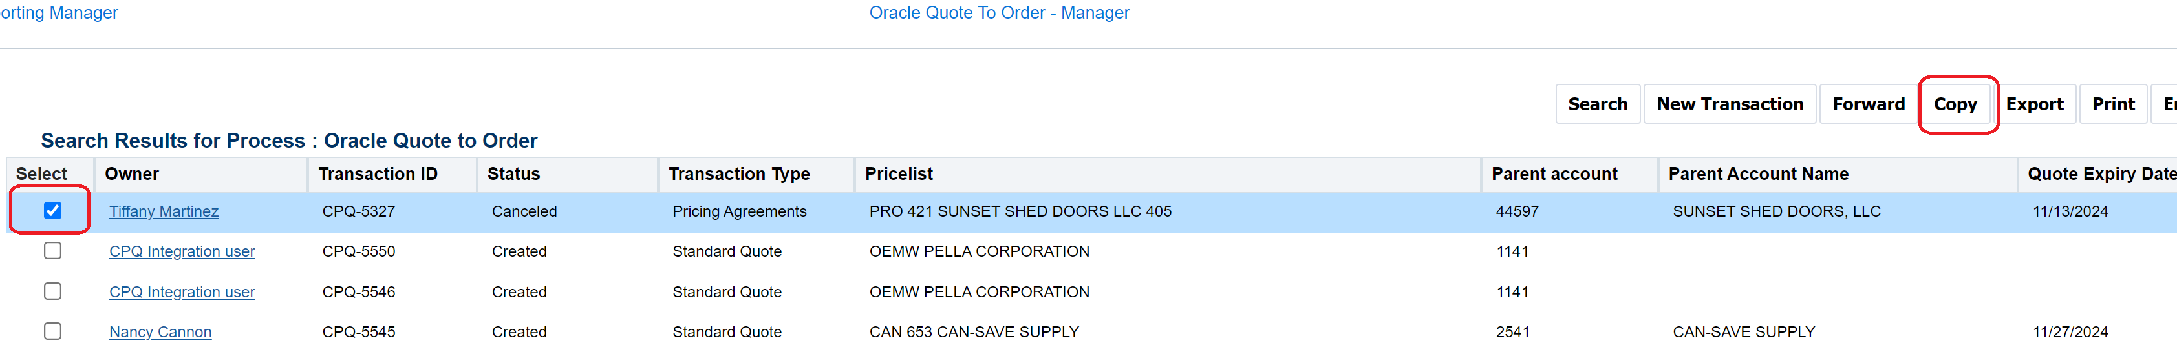
Repricing Unapproved Quotes
Once cancelled, the quote can be copied, adjusted, and resubmitted through the approval process.
To copy, find the quote in the main quote view, check the box shown below, then click the copy button. This creates a new CPQ-xxxx.
Once copied, follow this guide to reconfigure your door glass and resubmit through approval (slide 37).

Slide 43

Questions?

