Slide 1
2021 PowerPoint Template Use Example
January 2021
By: The Corporate
Communications Team

Slide 2
Designing a PowerPoint Presentation

Slide 3
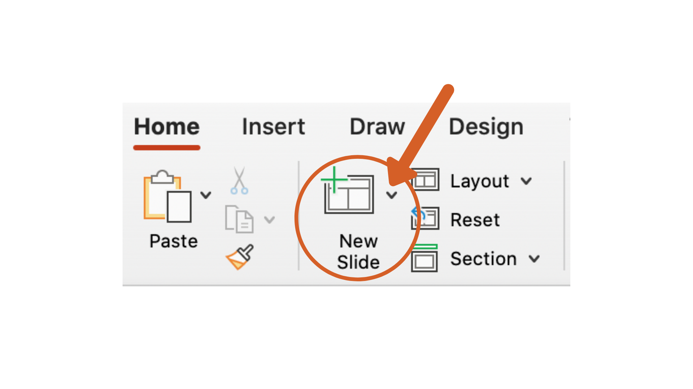
Discovering the Options
There are several design options to choose from in the 2021 PowerPoint Template
  To see the options –
    Press the arrow next to the “New Slide” icon

Slide 4
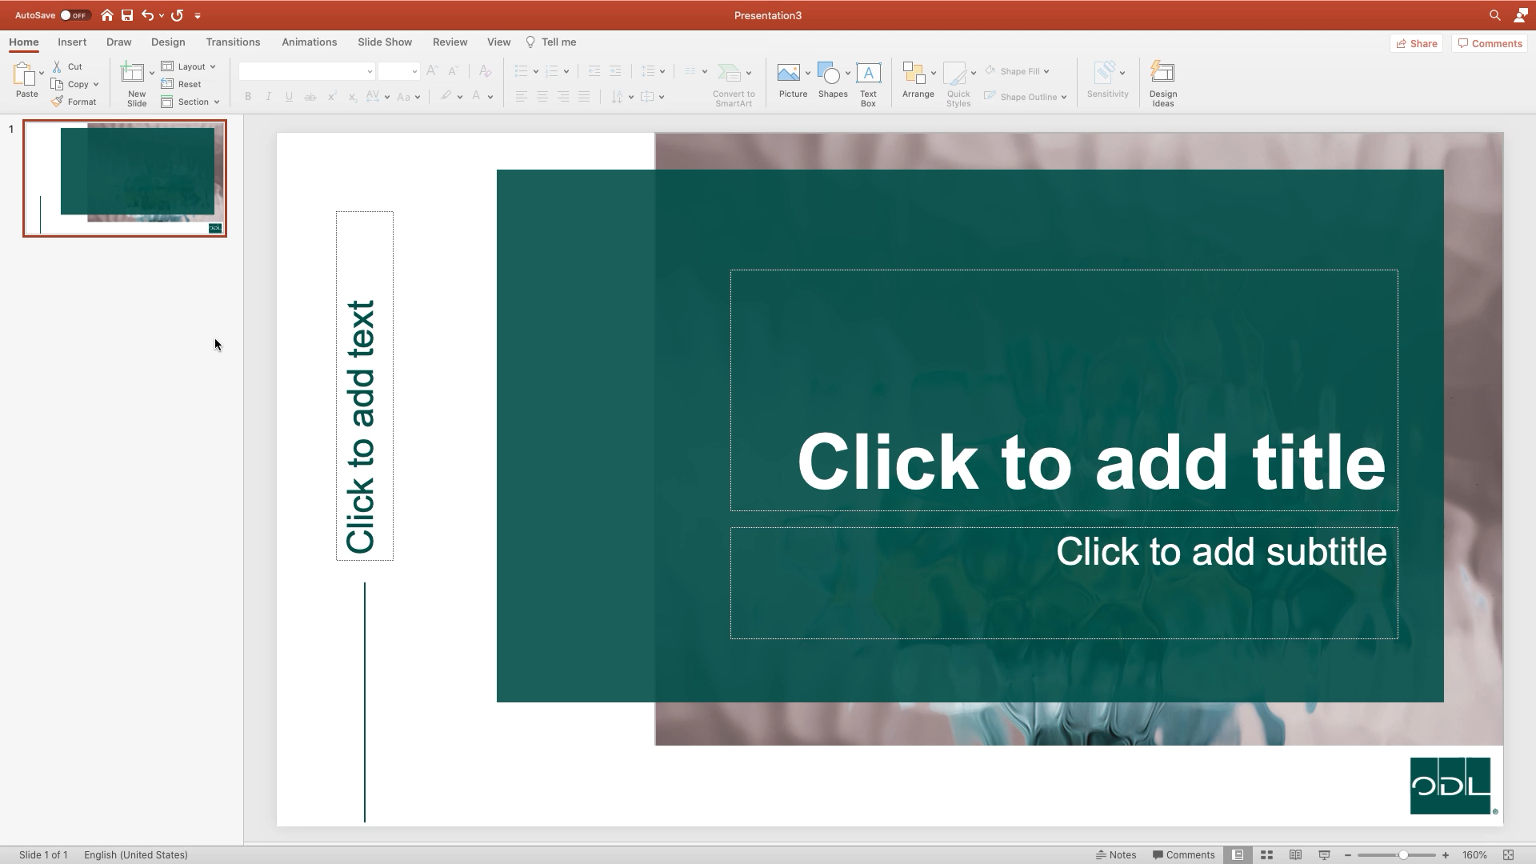
Exploring the Options
Explore your options
  Title Slides, Section Slides, and a variety of Content Slides
  Different colors and background photos to make your presentation unique
    Watch this video for help

Slide 5
Utilize Different Backgrounds

Slide 6
Background Images
Feel free to mix and match the different background images
  For example, switch to a different background image when beginning a new section
    The background images flow together, so you can use a variety while still maintaining a consistent flow throughout your presentation

Slide 7
Plain Backgrounds
Is a background image too distracting?
  Use the plain slide options
    They mix in perfectly with your presentation

Slide 8
How to Add in Different Content

Slide 9
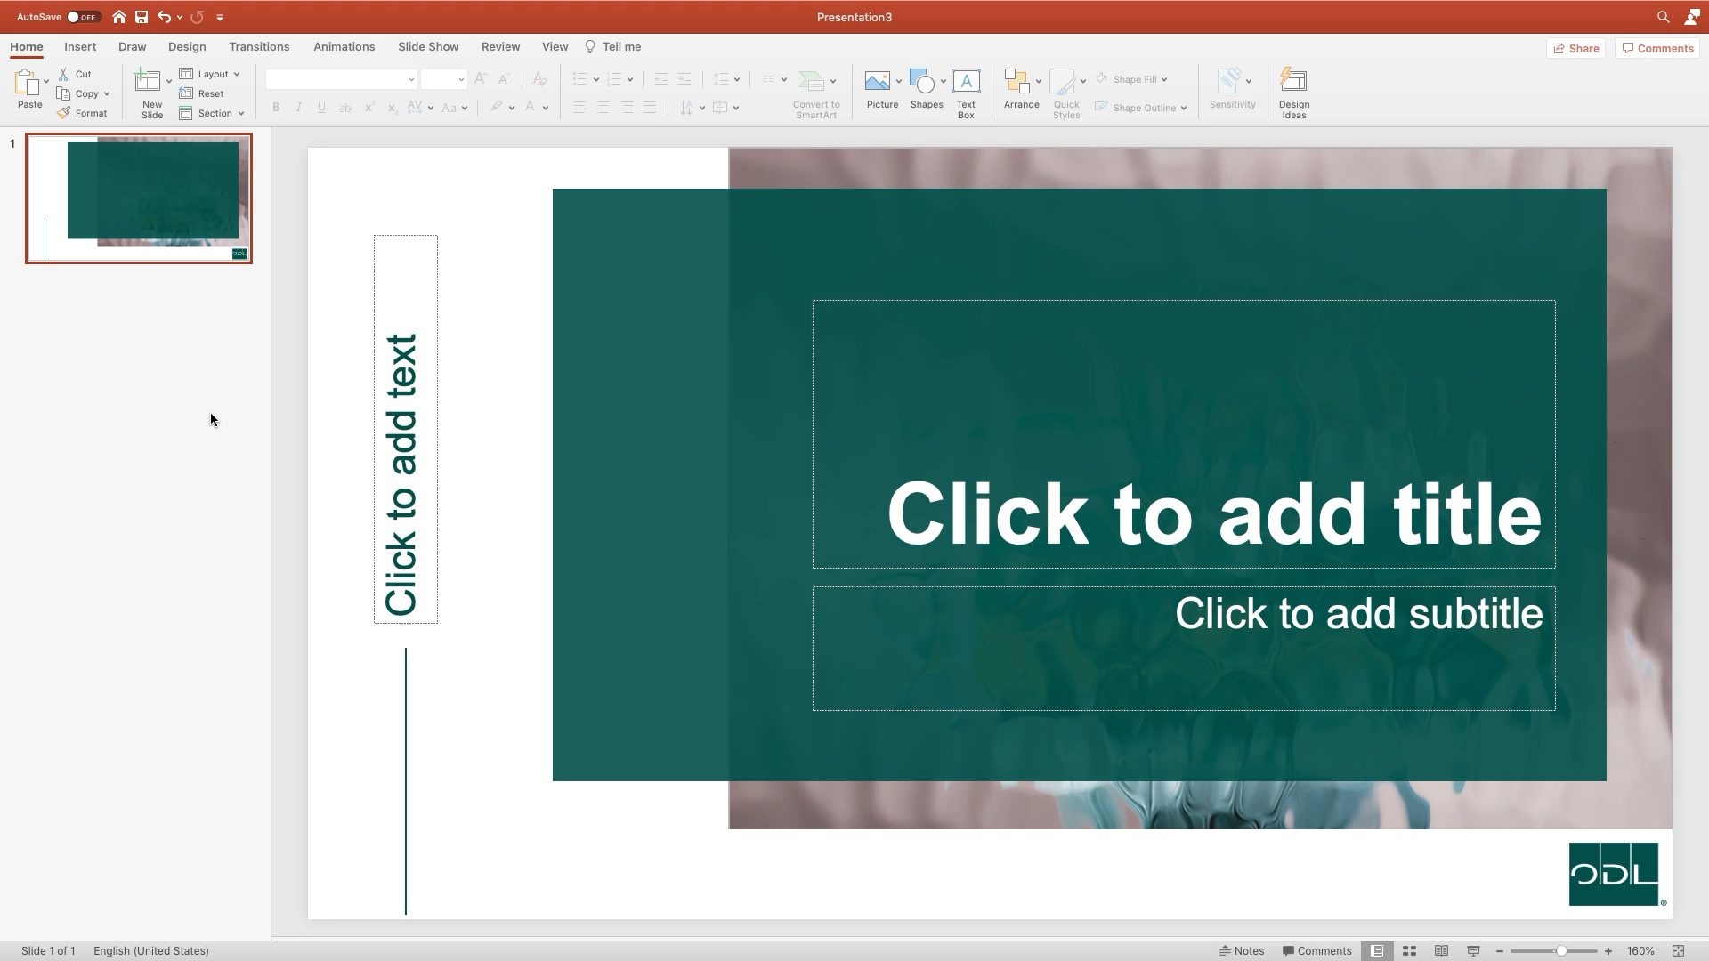
Add a Video Easily

Slide 10

Add Text and a Photo
Click the “Insert” tab
Click ”Pictures” and select your photo
If needed, resize the picture and text box to fit the slide

Slide 11



Add Multiple Photos

Slide 12
Add a Graph

