Slide 1
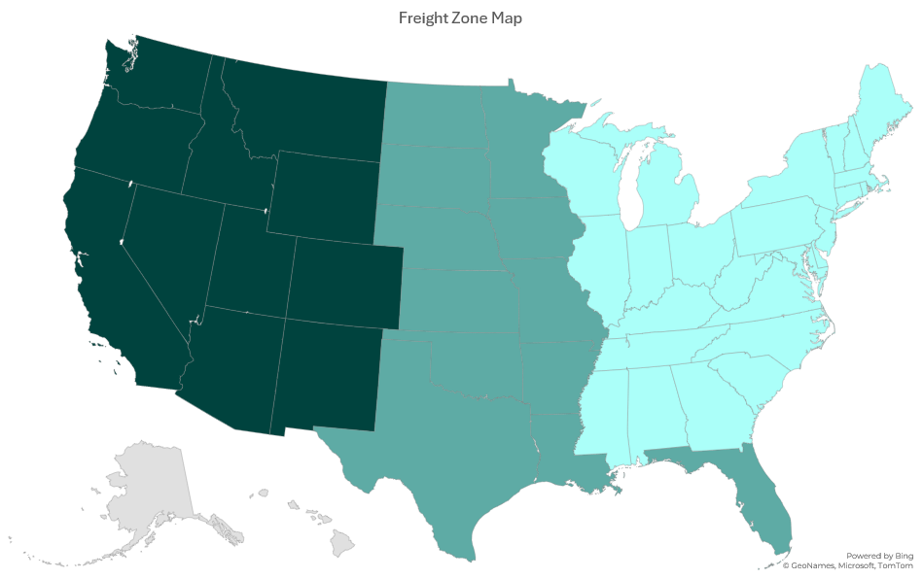
Zone 3
Zone 2
Zone 1
Zone 2

